Slide 1


AUTOMATING + SCALING KEYWORD RESEARCH
“Cool ways to get the data, and what to do with it”
Richard Baxter
SEOgadget.co.uk
This presentation will give you the skills required to collect and organise large volumes of keyword data allowing you to construct more meaningful site architecture for SEO.
Notes:
Introduction

Slide 2
it's about working smarter.

Slide 3

KEYWORD RESEARCH CONCEPTS

Slide 4
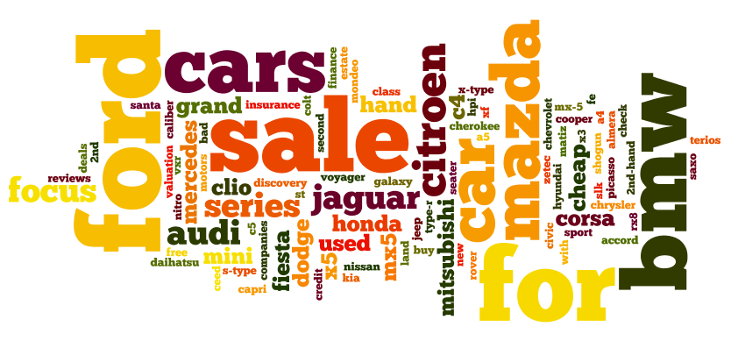
The BEAUTY OF UNCATEGORISED DATA
Using your newly acquired uncategorised data to inspire you to define categories and group keywords is incredibly powerful. Don’t be scared of big data!

Slide 5
What if you could group those keywords together so they made some actionable sense?
Action
Condition
Brand
Location
Model
Colour
Buy
Red
Audi
London
used
S3
If you can group keywords together, you can spot priorities in search behaviour that might allow you to confidently construct a site architecture

Slide 6
IF you understand top search terms by category, you can make decisions about your website
Action
Condition
Brand
Location
Model
Colour
buy
find
search
compare
locate
review
rate
Audi
BMW
Porsche
Black
Green
White
Yellow
Blue
used
new
second hand
S3
A3
X5
911
London
Nottingham
Peterborough
If you can group keywords together, you can spot priorities in search behaviour that might allow you to confidently construct a site architecture

Slide 7


It’s about opportunity
“In that gold mine of keyword data are dozens of likely search retargeting candidates…
My advice? Send that list on over to your paid marketer. Ask them to target these topics, site categories, etc. with their search retargeting ads until you have some more time and resources available to go after them.”
Keyword research for SEO should be marketing research for the whole company
http://www.seomoz.org/blog/leveraging-your-seo-for-search-retargeting

Slide 8
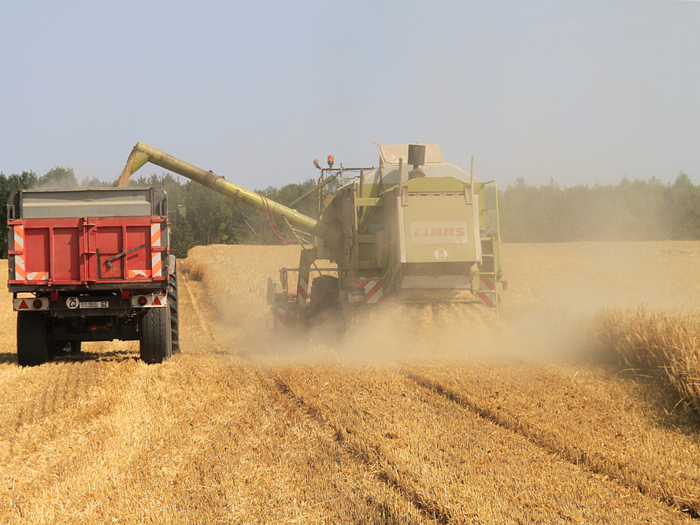
HARVESTING YOUR OPPORTUNITY

Slide 9

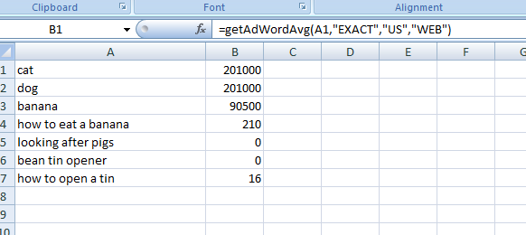
SEARCH VOLUMES JUST GOT SO MUCH EASIER
Happy MOZcon people! I’d love to hear your feedback, leave a comment, feedback on the speaker form or drop me a line (richard@seogadget.co.uk)

Slide 10

Google Adwords API Plugin for Excel
Get an Adwords API Key: http://code.google.com/apis/adwords/
Download: http://seogadget.co.uk/google-adwords-plugin-excel/
Sit back and generate your keyword volumes
=getAdWordStats()
=getAdWordIdeas()
Made for MOZCON: Capture search volumes and seasonality data straight into Excel http://seogadget.co.uk/google-adwords-plugin-excel/

Slide 11
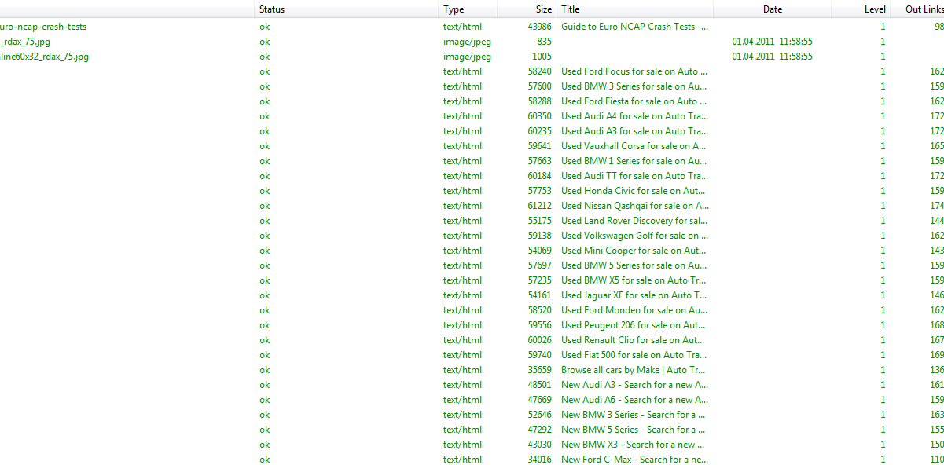
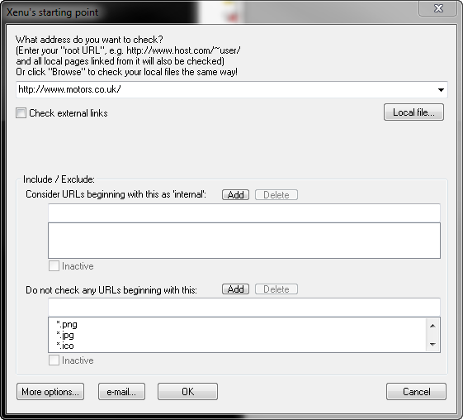

Competitor KW Extraction BY SITE CRAWL
Grab all of your competitors keywords: http://seogadget.co.uk/extract-your-competitor-keyword-strategy-excel-skills/

Slide 12
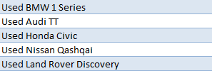
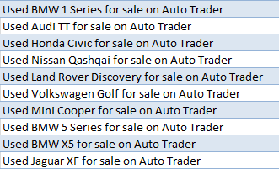
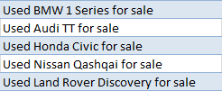
Extraction Methodology with XENU
=LEFT([@Title],FIND(" for sale",[@Title],1))
=MID([@Title],1,FIND("on Auto",[@Title],1)-1)
Large, optimised sites are often extremely predictable. If you can extract the data (and if it’s easy to get search data) then why not give this a shot?

Slide 13
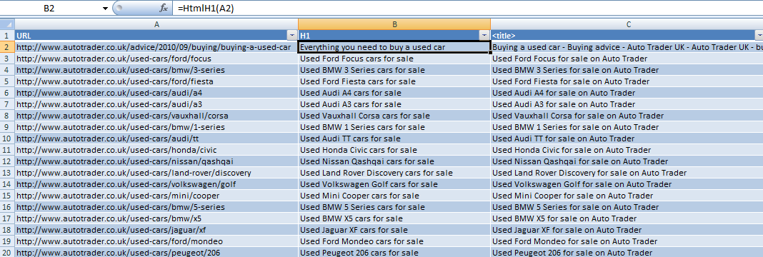
AWESOME: SEO tools for EXCEL
=HtmlH1() =HtmlH2() =HtmlTitle() =HtmlMetaDescription() =HtmlMetaKeywords()
=FacebookLikes() =httpStatus() =XPathOnUrl()
Check out Neils Bosma’s awesome SEOtools for Excel. AWESOME. http://nielsbosma.se/projects/seotools/

Slide 14
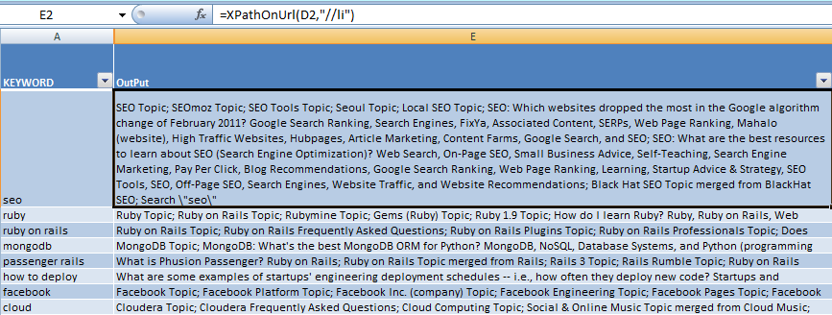
QUORA SUGGEST SCRAPING
Use concatenate to form query URL then:
=XPathOnUrl([URL],"//li")
Google Docs style Xpath scraping is easily possible. Separate into columns using the “;” delimiter. In theory this would work with any XML style search suggest output...

Slide 15
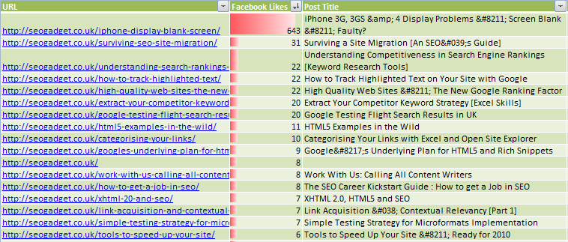
What do people like?
Import XML Sitemap > Fetch FaceBook Likes > Get post titles
Using =FacebookLikes() can rapidly increase your understanding of what visitors to competitor sites will like (http://nielsbosma.se/projects/seotools/ )

Slide 16
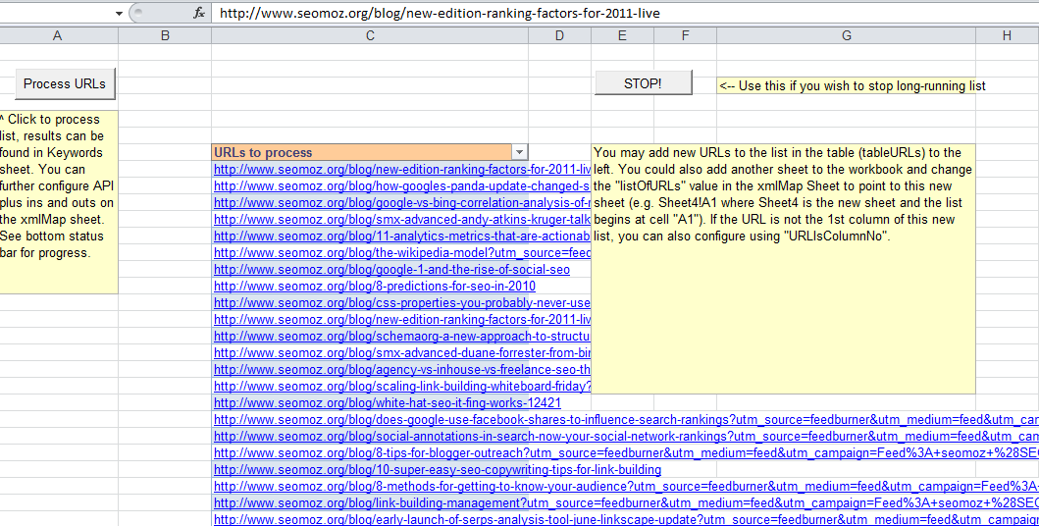
Alchemy
Download this tool: http://bit.ly/alchemyexcel and get an Alchemy API key here: http://www.alchemyapi.com/api/register.html - use a website’s top pages report (OSE) ☺

Slide 17
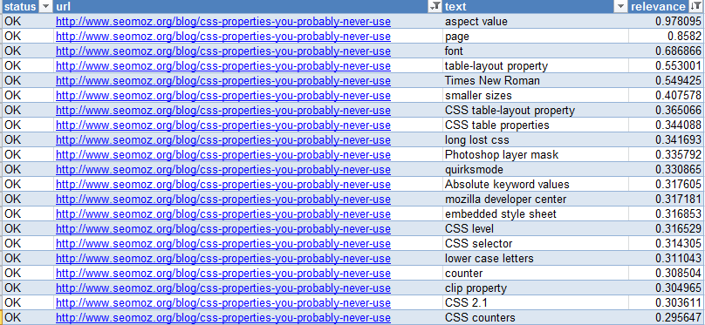
More Keywords!
Alchemy is particularly awesome at tagging and categorising content. It can be used to identify entities in content (http://www.alchemyapi.com/api/entity/) and it has a very powerful content scraper (http://www.alchemyapi.com/api/scrape/) which can extract content without the use of xPath

Slide 18
POPULAR Internal Site Search TERMS
Check out the start pages report in GA – what pages do people search on? What terms do they use and do they find what they’re looking for?

Slide 19
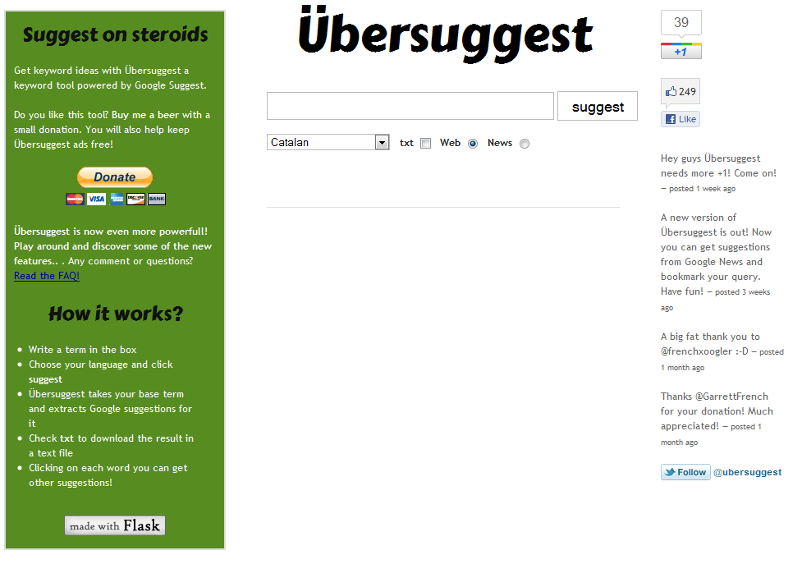
Google SUGGEST
Ubersuggest. THE Google suggest scraper tool. Also scrapes Google News!

Slide 20
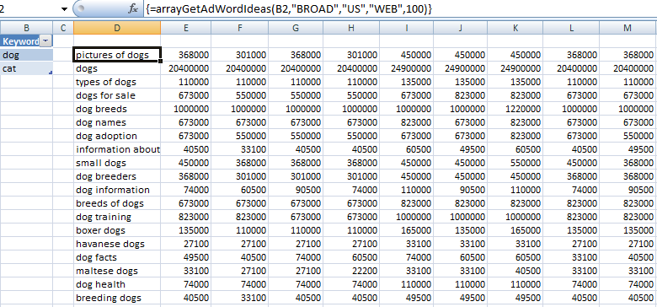
SUGGEST SCRAPING WITH EXCEL
=arrayGetAdWordIdeas(B2,"BROAD","US","WEB",100)
Yep. If you want keyword ideas, then rock out SEOgadget’s adwords API plugin.

Slide 21
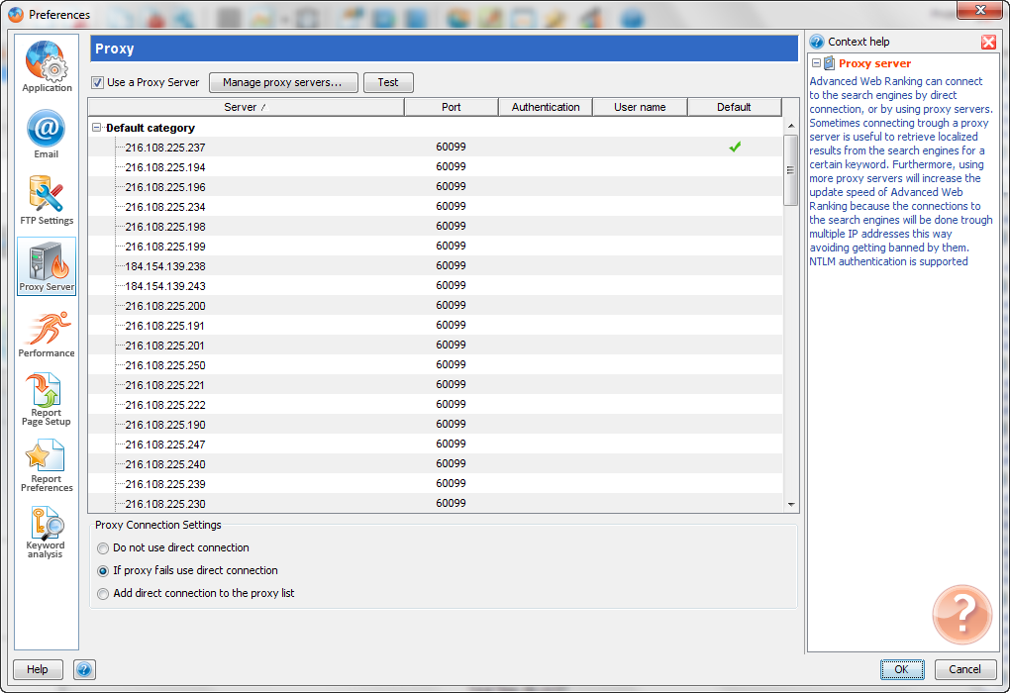

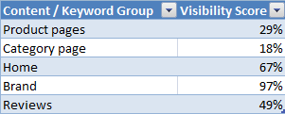



Fetching the right Ranking Data
Rank checking is never perfect, but If you’re using a decent proxy service located in the correct host location, the data is useful – especially for measuring visibility by keyword group / content type

Slide 22
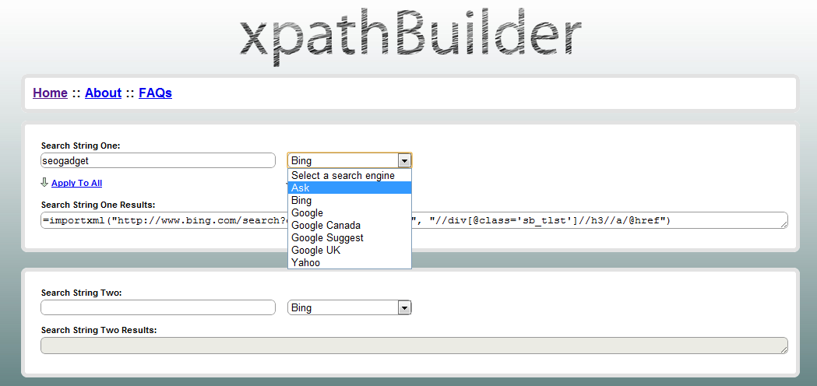
CAPTURE RANKINGS IN GDOCS
Check out the point made by Tom Critchlow about the use of the &time query for larger scrapes here: http://seogadget.co.uk/playing-around-with-importxml-in-google-spreadsheets/

Slide 23
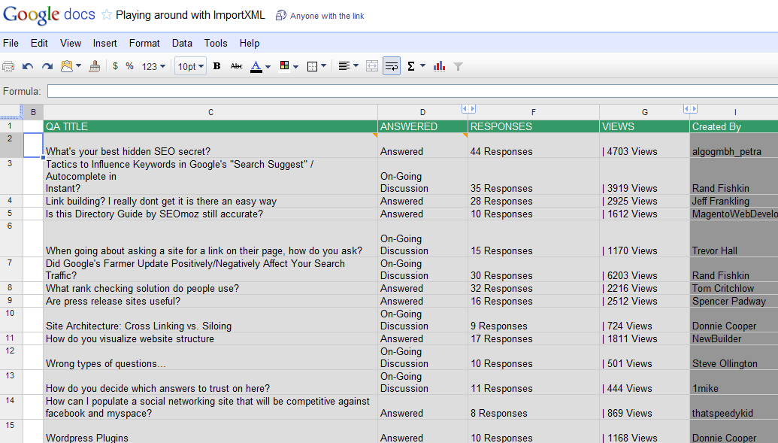
QA Forums are AWESOME FOR BLOG POST IDEAS
http://www.seomoz.org/q/browse?utf8=%E2%9C%93&visibility=0&time_range=0&sort=0&x=54&y=9&limit=10
View this Gdocs spreadsheet: http://bit.ly/9Fs7aF via: http://seogadget.co.uk/playing-around-with-importxml-in-google-spreadsheets/ then learn how to do the job properly: http://www.distilled.net/blog/distilled/guide-to-google-docs-importxml/

Slide 24
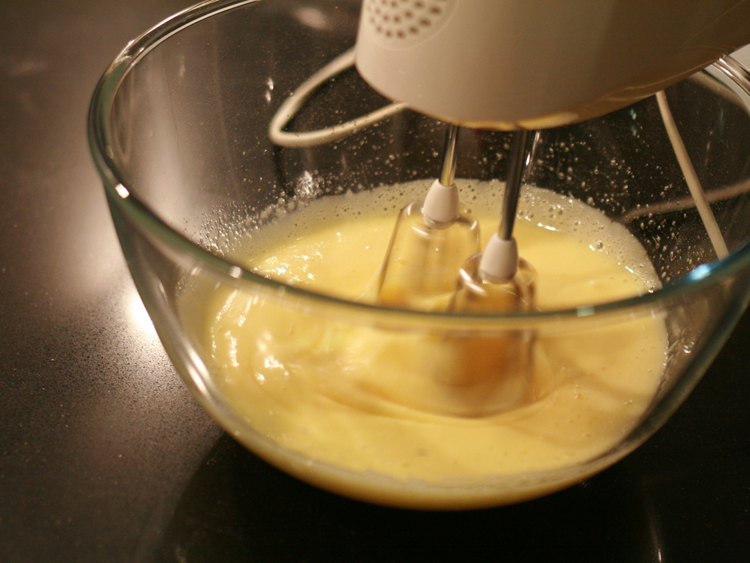
THE PROCESS
Credit: Missy & The Universe

Slide 25
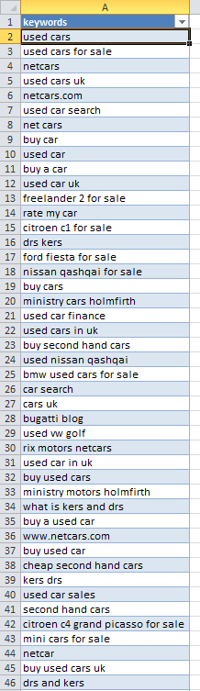
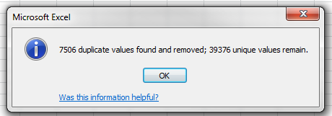
Build a Master List – and De-DUPE
Create tabs for every individual data set we’re going to create – PPC, Webmaster Tools, Ranking, Analytics, Web Search Volumes and Mobile Search

Slide 26
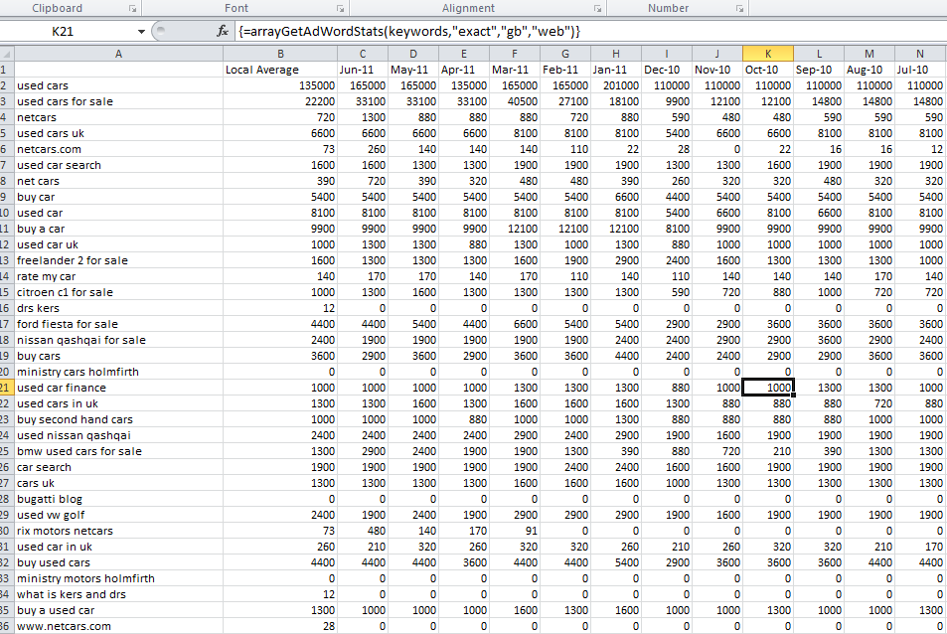
In A NEW SHEET GRAB THE SEARCH VOLUMES
=arrayGetAdWordStats(KEYWORDS,”EXACT”,”US”,”WEB”)
=arrayGetAdWordStats(KEYWORDS,"EXACT","GB","MOBILE")
The Adwords API plugin works with very long lists of keywords in arrays – 40,000 keywords took my desktop PC about 10 minutes ☺

Slide 27
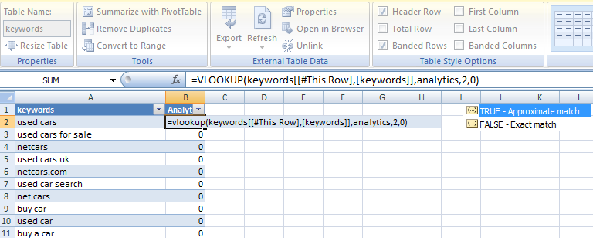
Start Building your master data table with VLOOKUPS
=VLOOKUP([lookupvalue],[tablearray],[column],0)
IFERROR([VALUE],[VALUE IF ERROR])
Consolidate all of the data you’ve collected into one master data table. VLOOKUP may create errors where no data exists, so use IFERROR to keep things N/A free

Slide 28
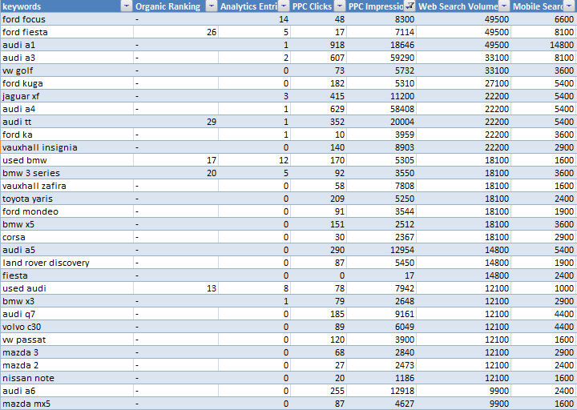
COMBINE ALL THE DATA
A near complete master data table prior to moving into categorisation mode. You should include everything you can get your hands on, especially PPC, Conversion, Mobile Search

Slide 29
CONCEPTS: The POWER OF Categorising the uncategorised
Creating categories from chaos - a starting point in keyword research is an incredibly rich and powerful source of inspiration.
You’re going to see how using uncategorised, raw keyword data as a start point can quickly lead to discovery and new opportunity

Slide 30
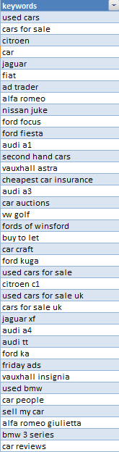
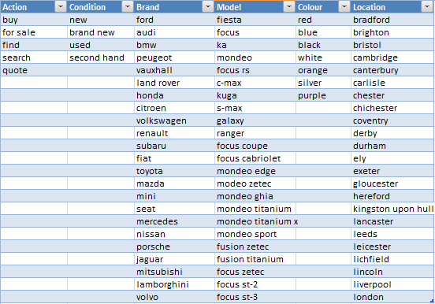
DEFINE YOUR CATEGORIES
condition
brand
model
location
Guide
NEW!
Define your categories by working through your uncategorised list – as you identify new groups, take a note of the markers that would indicate a term belongs to the group

Slide 31
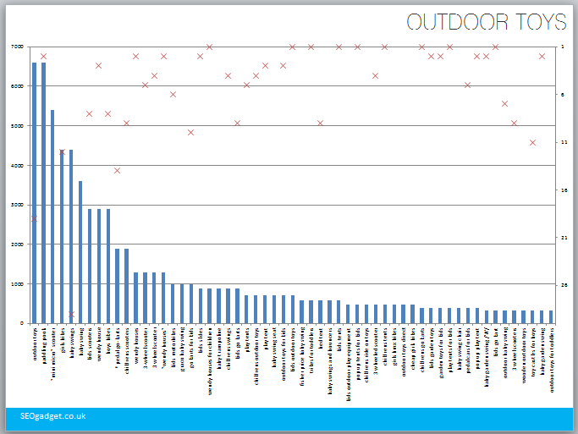
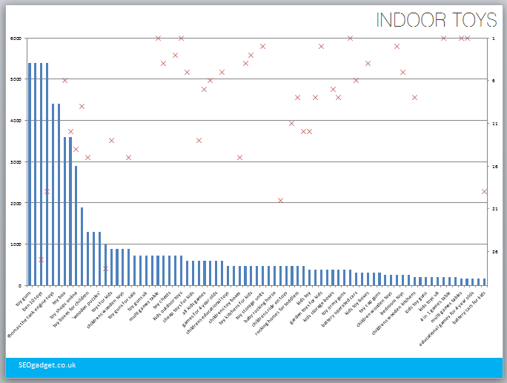
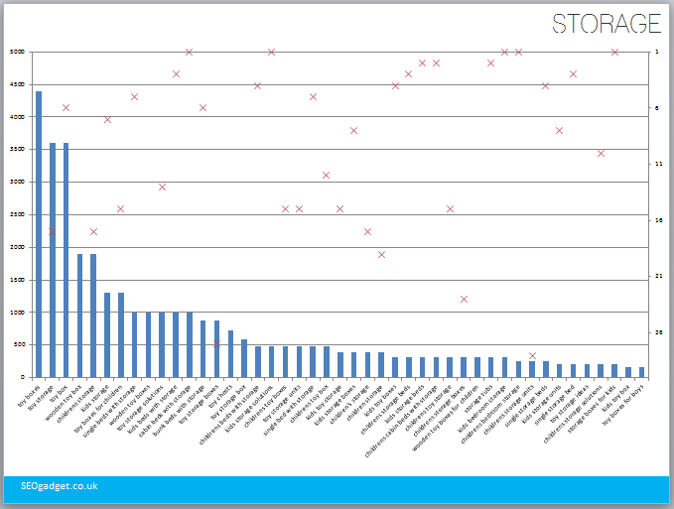
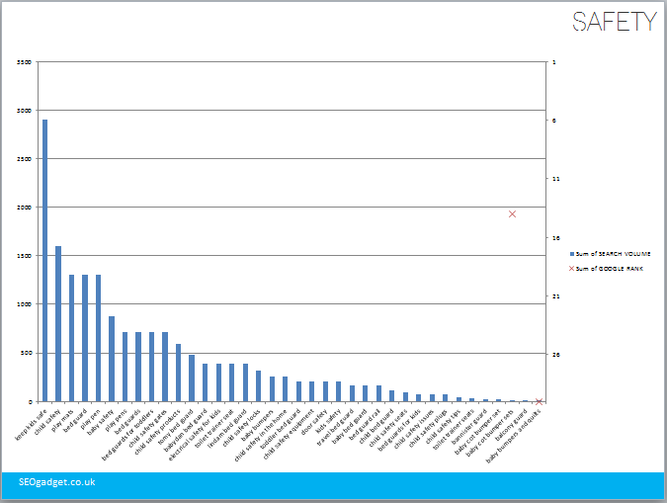
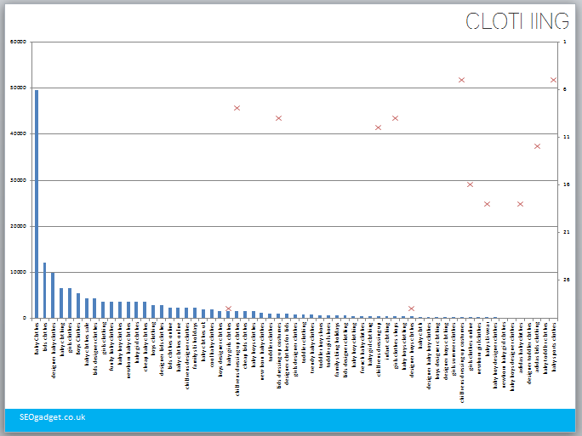
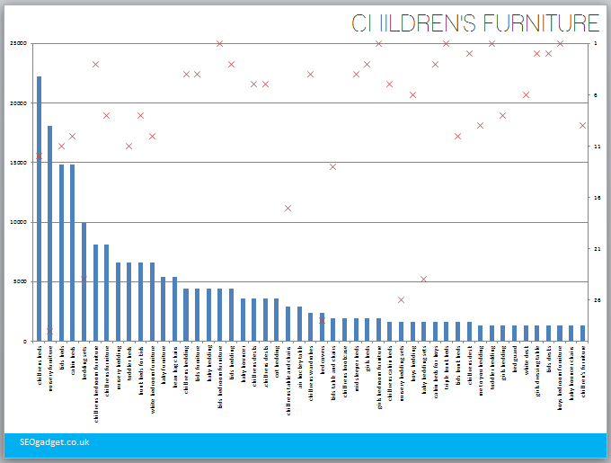
HOW DO I BUILD KEYWORD CATEGORIES?
You’ll need to make sure you can do this: http://seogadget.co.uk/how-to-make-a-pivot-table-and-chart-in-excel/

Slide 32
MORE Awesome Excel Queries
FIND()
find text within text – this will give you the start number of the string of characters you’re looking for
ISNUMBER()
check whether a value is a number and return a false if there’s no value and true if there is
The trick with any Excel query is to play with each individual query string in turn. That way, when you build a nested query – you’ll know what to do if you need to debug

Slide 33
One Query to rule them all
=IF(SUM(NOT(ISERROR(FIND('KW TYpes'!$A$2:$A$4,$A2)))*1)>0,C$1,"Non-"&LOWER(C$1))
found in this cell
Return a start
position
of anything in
this range
Prettify the
output
Our query checks across an array for strings that can be found in the keyword in cell A2. The output uses the column name to return a easy to understand label.

Slide 34
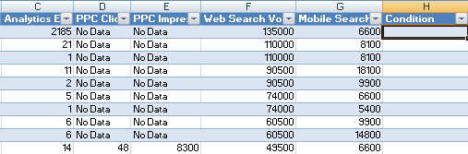
Step 1: Create a Column
Create a table column in your main table

Slide 35
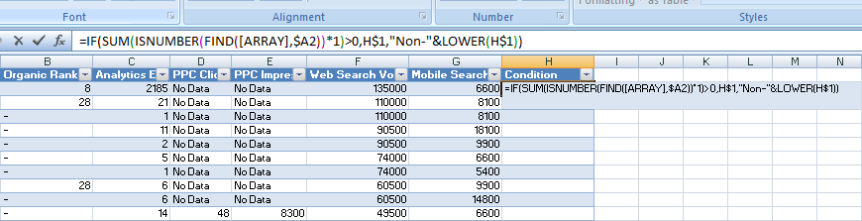
Step 2: Add the Formula
Paste the formula into your table. Make sure the column reference (“H”) matches in the formula. Highlight the “[ARRAY]” section and click the “KW TYPES” tab

Slide 36
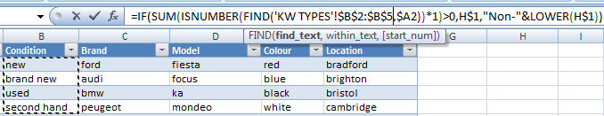
Step 3: Select Your Marker list
Highlight the list of markers for your category, press F4 and then CTRL+SHIFT+ENTER

Slide 37
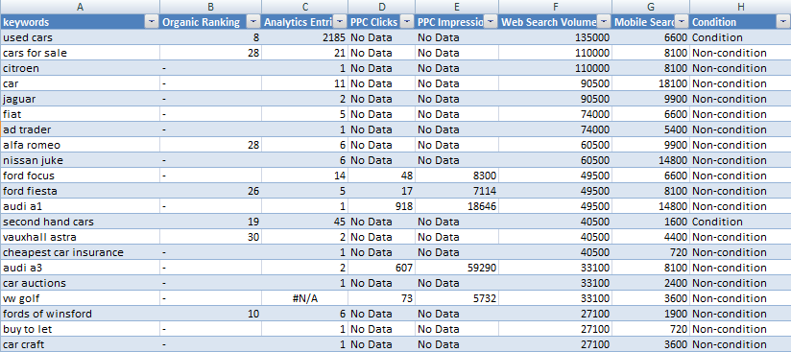
STEP 5: RINSE AND REPEAT
NEW!
Product
Rinse and repeat – keyword research is iterative. As you work through your list you’ll discover new opportunities to create new keyword groups

Slide 38
CONCEPTS: CATEGORY COMBINATIONS
You can combine or exclude specific categories to answer questions!
The real power of keyword research is combining segments to really deep dive into understanding what people are looking for

Slide 39
Examples
- People in London who want to know who provides the fastest mobile broadband
- People looking for laptop reviews who aren’t interested in business machines or who want Ubuntu pre installed
- People searching for flights with a specific Airline who want to fly to New York
All achievable with filtering and segmentation – set up your categories wisely and go off and explore

Slide 40
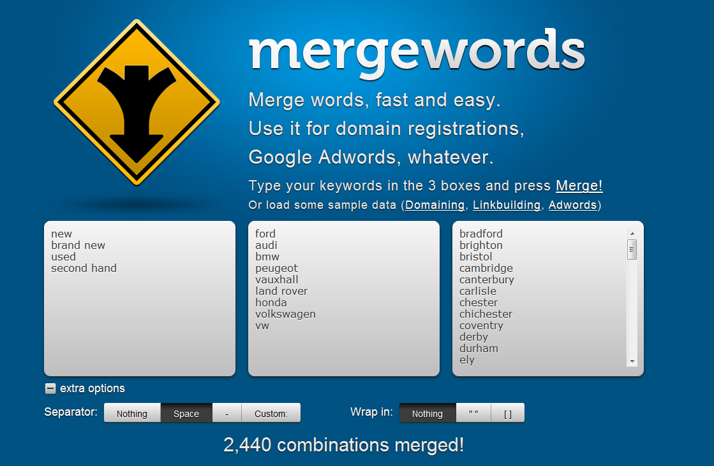
As you identify new categories and areas you’d like to explore, try generating a list of very specific terms using a combination of the markers you’ve generated using mergewords.com

Slide 41


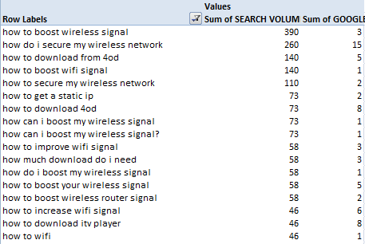

The Blog / Guides category
You can use this process for blog content ideas – at least it’s a start! Use markers that indicate a research intent such as “guide”, “how to” etc. Don’t forget that surveys, your own long tail, Google suggest and QA are great sources of inspiration, too.

Slide 42

ARCHITECTURE
Credit: Mary Firth

Slide 43
For DYNAMIC SITES: Keyword Strategy
Content Group 1
(HOME)
“Airline tickets”
“Flights”
“Cheap flights”
Content Group 2
(DESTINATION)
“Flights to #”
“Cheap flights to #”
Content Group 3
(ROUTE)
“Flights from @ to #”
“Cheap flights from @ to #”
“@ to #”
“@ to # Flights”
Content Group 4
(AIRLINE BRAND)
“[BRAND] Flights”
“[BRAND] Flights from @ to #”
“@ to # Flights”
Understanding the make up of your user’s search behaviour is an important step to defining longer tail dynamic site templates

Slide 44
WHAT links SHOULD I FEATURE ON MY HOMEPAGE?
Action
Condition
Brand
Location
Model
Colour
Making a chart like this is just so insanely easy – Google “SEOgadget pivot charts” or follow this link: http://seogadget.co.uk/how-to-make-a-pivot-table-and-chart-in-excel/

Slide 45
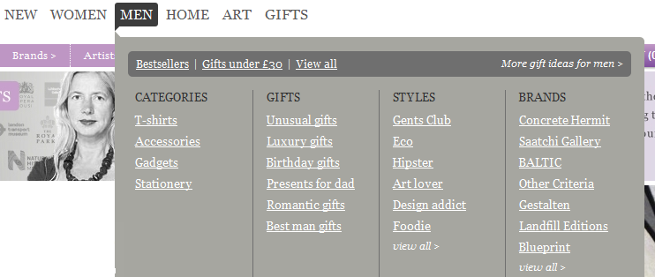
WHAT ABOUT NAVIGATION?
Suggested Navigational Structure
Category: Outdoor toys
Children’s Bikes
  Girls Bikes
  Boys Bikes
Paddling Pools
Scooters
  Kids Scooters
  3-Wheel Scooters
  Mini Micro Scoters
Wendy Houses
  Play Houses
  Play Tents
  Toy Castles
Kids Motorbikes
Go Karts
  Pedal Go Karts
  Pedal Cars
  Kids Quad Bikes
Swings
  Baby Swings
Garden Games
Climbing Frames
See Saws
Slides
Toddler Scooters
Toddler Trikes
Trampolines
Subcategory name
Category name
Sub-Sub Category name
If you’ve built bullet proof categorisation in your keyword research, you can start thinking about putting your navigational structure together

Slide 46
AND You CAN QUICKLY BUILD OUT THE WHOLE THING
Category: Children’s Toys
Dolls Houses
Dressing Up
Games Tables
  Football Tables
  Air Hockey Tables
  Multi Games Tables
Online Toy Shops
Play Kitchens
Pool and Snooker Tables
Pop Up Tents & Wendy Houses
Barbie Toys
Battery Powered Cars
Rocking Horses
Educational Toys
  Science Toys
  ABC Games / Alphabet Games
  Early Learning Games
Table Tennis Tables
Children’s Wooden Toys
  Rocking Horses (Baby & Toddler)
  Wooden Puzzles
  Wooden Kitchens (Children)
Category: Kids Clothes
Baby Clothes
  Designer Baby Clothes
  Baby Clothes Sale
  Baby Girl Clothes
  Baby Boy Clothes
  Newborn Baby Clothes
  Funky Baby Clothes
Girls Clothes
  Girls Designer Clothes
Boys Clothes
  Boys Designer Clothese
Kids Designer Clothes
Childrens Dressing Up Clothes
Toddler Clothes
Children’s Nightwear
  Boys Pyjamas
  Girls Pyjamas
  Boys Dressing Gowns
  Girls Dressing gowns
  Babygrows
Toy Storage
Toy Boxes
  Wooden Toy Boxes
  Kids Toy Boxes
  Character
Toy Storage Ideas
  Toy Storage Ideas
  Boys Storage Boxes
  Girls Storage Boxes
Kids Bedroom Storage
  Toy Chests
  Kids Bedroom Storage
Character Toy Boxes
  Winnie The Pooh Toy Boxes
  Thomas the Tank Engine Toy Boxes
  Barbie Toy Boxes
  Ben 10 Toy Boxes
Category: Kids Bedding, Curtains, Rugs and Beanbags
Childrens Bedding (Kids)
  Childrens Duvet Covers
  Children’s Bed Linen
Toddler’s Bedding
Boy’s Bedding
Girls Bedding
Nursery Bedding
Childrens Curtains (kids)
  Winnie the Pooh Curtains
  Boys Curtains
  Girls Curtains
  Football Curtains
  Ben 10 Curtains
  Toy Story Curtains
  Hello Kitty Curtains
  Thomas the Tank Engine Curtains
Childrens Rugs
  Bedroom Rugs
Bean Bags for Kids
  Childrens Bean Bag Chairs
Category: Child Safety Products
Play Mats
  Baby Play Mats
  Toddler Play Mats
  Car / Road Play Mats
  Outdoor Play Mats
  Foam / Soft Play Mats
Bed Guards
  Bed Guards for Toddlers
  Baby Bed Guards
  Child Bed Guards
  Lindam Bed Guards
  BabyDan Bed Guards
  Tomy Bed Guards
Child Safety Gates
  Lindam Safety Gates
  Kiddyguard Safety Gate
  Baby Safety Gates
  Toddler Safety Gates
Category: Kids Lamps / Childrens Lamps
Childrens Bedroom Lamps
  Childrens Bedside Lamps
  Bedside Lighting
Childrens Light Shades
  Bart Simpson light Shade
  Ben 10 Light shade
  Thomas the Tank Engine Light Shade
  Animal Light Shade
  Dinosaur Light shades
Childrens Nightlights
  Toddler Go Glow Lights
Category: Baby Care
Baby Bouncers
  Baby Door Bouncer
  Fisher Price Baby Bouncers
Baby Swings
  Fisher Price Baby Swing
  Graco Baby Swing
Baby Bathing & Training
  Baby Bath Seats
  Baby Bath Seats
  Potty Training
  Baby Bath Accessories
Baby Monitors
  Digital Video Baby Monitors
  Long Range Baby Monitors
  Baby Movement Monitors
  Nappy Monitors
Baby Outdoors
  Baby Travel Cots
  Baby Safety Nets
  Baby Sunshades
Category: Childrens Room Decoration
Kids WallPaper (children’s)
  Nursery Wallpaper
  Kids Bedroom Wallpaper
  Kids Wallpaper Borders
  Kids Wallpaper Murals
Children’s Character Wallpaper (Kids)
  Kids Arsenal Wallpaper
  Kids Ben10 Wallpaper
  Thomas the Tank Engine WallPaper
  Toy Story Bedroom Wallpaper
  Disney Cars Bedroom Wallpaper
  [Additional Characters here]
Childrens Wall Stickers (Kids)
  Kids Bedroom Wall Stickers
  Baby Nursery Wall Stickers
  Disney Wall Stickers
  Fairy Wall Stickers
  Winnie the Pooh Wall Stickers
  Football Wall Stickers
  Space Wall Stickers
Things for Girls
gifts for girls
girls clothes
girls bikes
baby girl clothes
christening gifts for girls
girls bedroom furniture
girls beds
baby girls clothes
gifts for teenage girls
girls dressing table
girls bedding
girls designer clothes
girls bedroom
girls curtains
girls bedroom accessories
girls bmx bikes

Slide 47
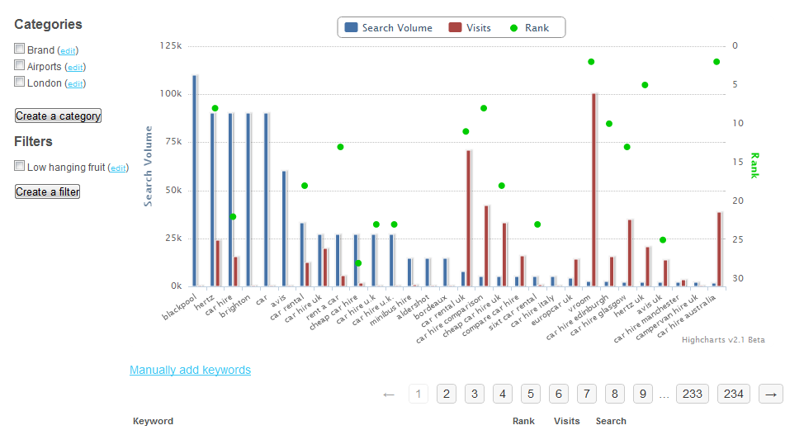
AT SCALE KEYWORD RESEARCH
FETCH ANALYTICS KW
GATHER ADWORDS SV
COLLECT RANKINGS
CATEGORISE + FILTER
We built a ruby on rails keyword research web application using MongoDB to run the categorisation extremely quickly across accounts of 10,000 keywords. Whew!

Slide 48
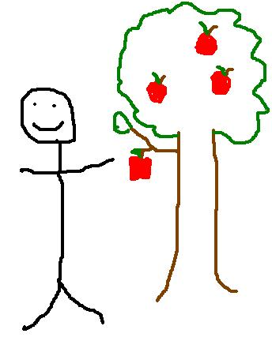
CONCEPTS: LOW HANGING FRuit
Keywords that rank around the bottom of page 1 or around the top of page that that are receiving organic search traffic could be extremely valuable
Low hanging fruit – the easiest and potentially highest value keywords in terms of ROI, if you have the content...

Slide 49
Row Labels | Sum of SEARCH VOLUME | Sum of GOOGLE RANK | Sum of VISITS
fathers day gifts | 9900 | 9 | 12
fire pit | 5400 | 8 | 14
door stops | 4400 | 12 | 127
big boys toys | 4400 | 14 | 29
birthday gifts for men | 2400 | 9 | 16
candle making kits | 1600 | 10 | 167
folding shoes | 1000 | 11 | 9
bar accessories | 1000 | 10 | 31
black and blum | 880 | 10 | 14
cyber clean | 880 | 13 | 11
aroma home | 880 | 9 | 56
dad gifts | 720 | 11 | 8
fire pits uk | 720 | 13 | 7
boys gifts | 590 | 11 | 83
experience days uk | 590 | 10 | 7
digital keyring | 480 | 14 | 23
addict-a-ball | 480 | 13 | 18
RANK >15th <5th
HAS ADWORDS SEARCH VOLUME
HAS ANALYTICS ENTRIES
HAS COMMERCIAL VALUE?
For extra points, run your low hanging fruit terms through Google Suggest, fetch the rankings and search volumes for your site and re-apply the low hanging fruit filter!

Slide 50


THANK YOU
Say hi: richard@seogadget.co.uk
@richardbaxter
Thanks for listening! Check out our blog at SEOgadget.co.uk for more actionable guides and tips and do get in touch with feedback / questions.
Notes:
Introduction

