Slide 1
MozCon 2011
Long Tail SEO in a Post-Panda World

Slide 2
Matthew Brown
matthew@audiencewise.com
Twitter: matthewjbrown
http://www.portlandground.com/archives/2003/05/steel_bridge_an.php

Slide 3
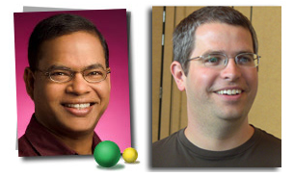
My one slide on Panda “theory”
No Whitelist. And we’re confident about sites that were affected
Panda likely has two components:
Quality Rater Team & Machine Learning

Slide 4
No risk: Great Content
Low Risk: Useful Content
High Risk: Everything Else
Obvious: There’s a sitewide organic Quality score now

Slide 6
Strategies for Right Now

Slide 7
Sample of Panda-affected sites across different verticals.
Surprises: Page Load Time and # of links

Slide 8
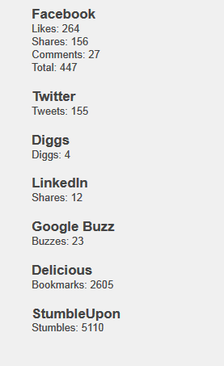
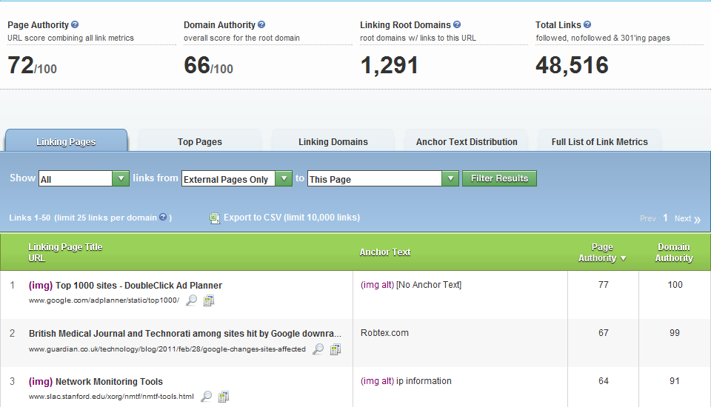
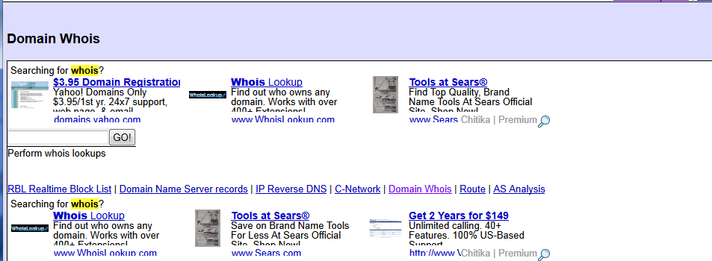
Robtex.com – Useful but Invisible.
The Content
Links and social signals won’t save you from low quality

Slide 9
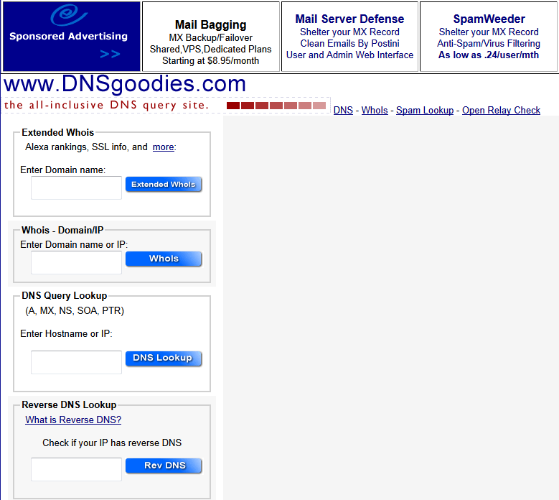
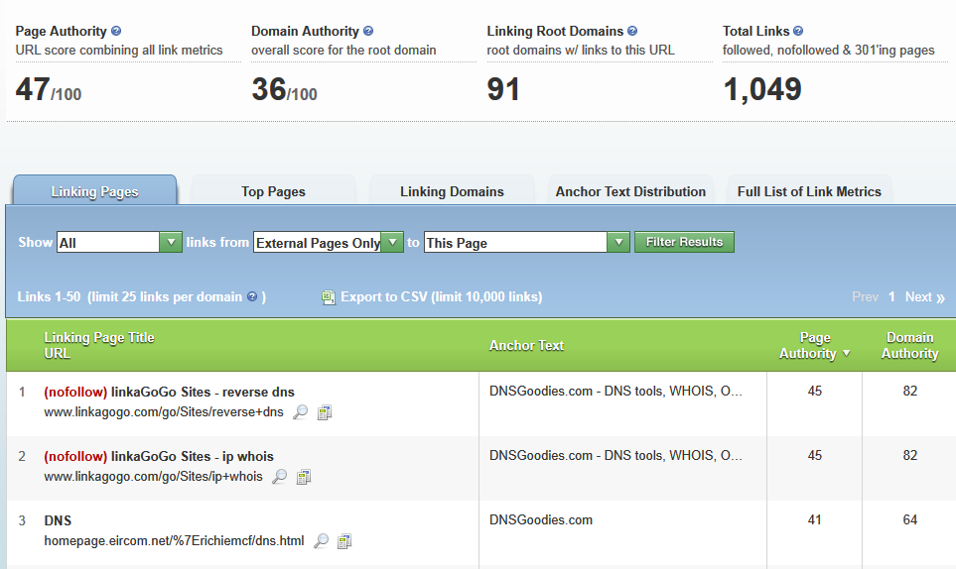
Best clues: What Google ranks even if it doesn’t have links

Slide 10
Panda-Proofing: Sitewide Strategies

Slide 11
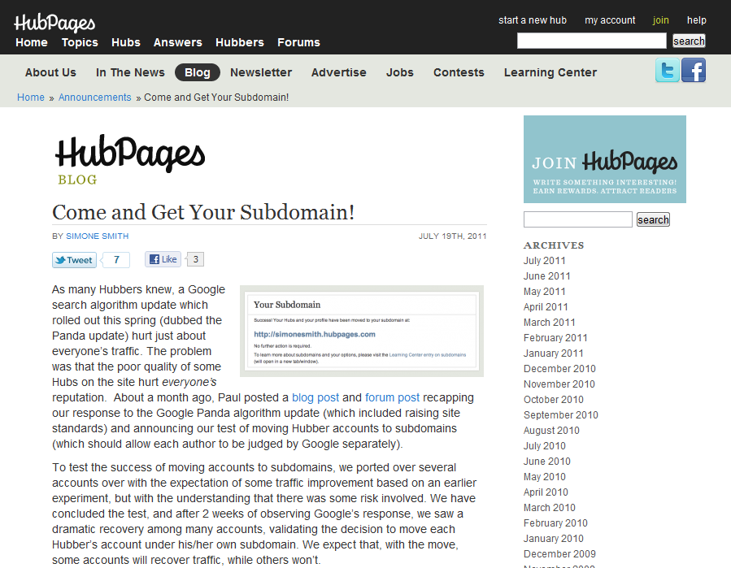
Use subdomains to segregate. They are NOT an escape.

Slide 12
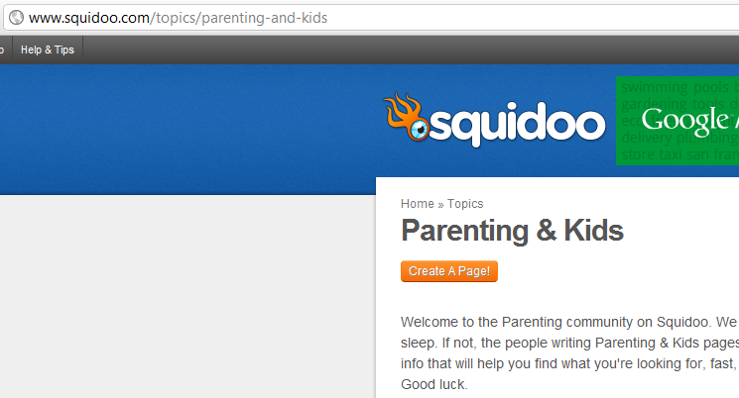
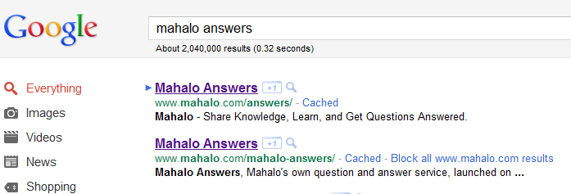
Topics/archives subdirectories are easy to burn down
I totally see what you did there.
Google ALSO knows how to pattern match subdirectories, so beware of tanking an entire site section

Slide 13
Ranks #2 for ‘Combining home and auto insurance’
Ranks #6 for ‘Homeowner’s Insurance Discounts’
Combine long tail keywords onto a single page wherever possible

Slide 14
Panda-Proofing: Page Level Strategies

Slide 15
The Curious Case of Andrew Hansen
“30% of the browser display area consists of unique and relevant content”
“Websites that are primarily occupied by display ads”
“Multiple Ads to the same site”
“The site is considered compliant if the area of ads is less than or equal to the area of content”
http://andrewhansen.name/affiliate-marketing/google-checkmates-me-but-reveals-internal-secrets/

Slide 16
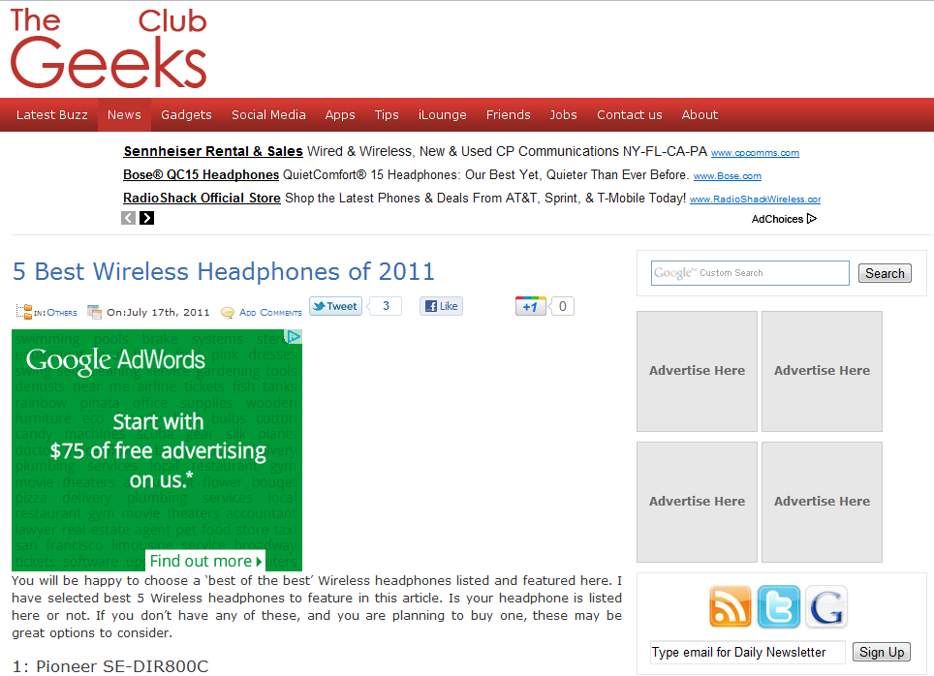
If you work in SEO/SEM, all this is easy to spot

Slide 17
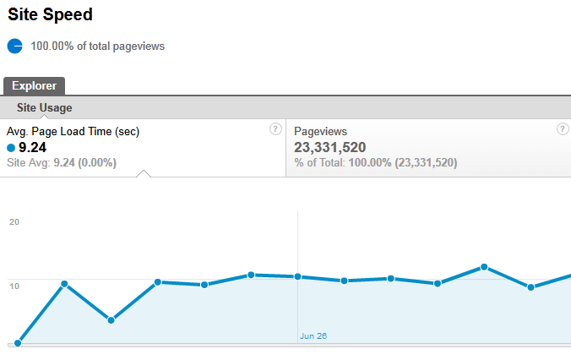
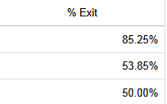
If you see a jump in bounce or exit rate around Page Load time, that’s your cue
Site speed as a user quality metric scares me

Slide 18
Maximizing Social Signals

Slide 19
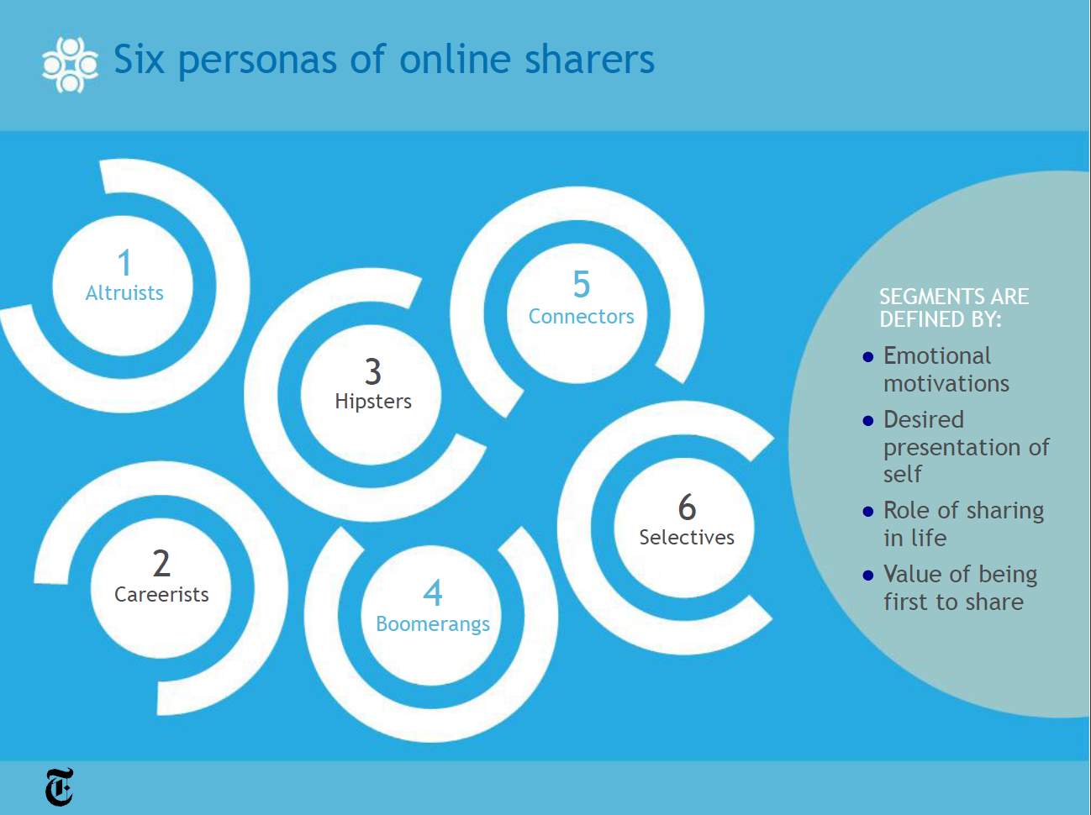
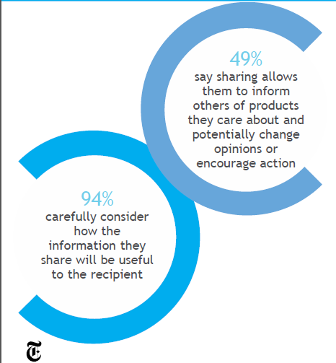
Studies are starting to show ‘share blindness’ depending on user intent

Slide 20
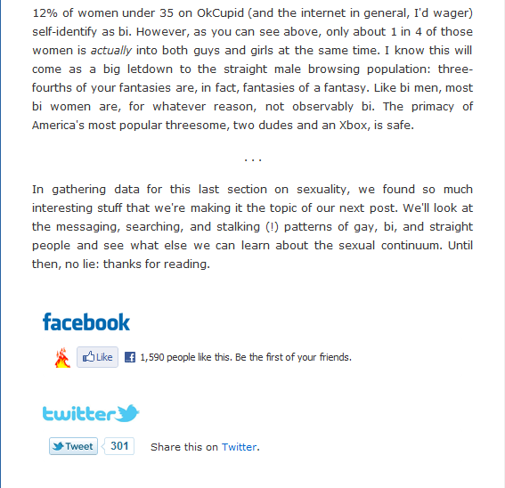
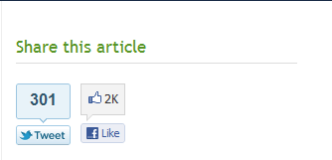
The usual sharing CTAs
Use any sort of specialized CTA to overcome ‘sharing blindness’

Slide 21
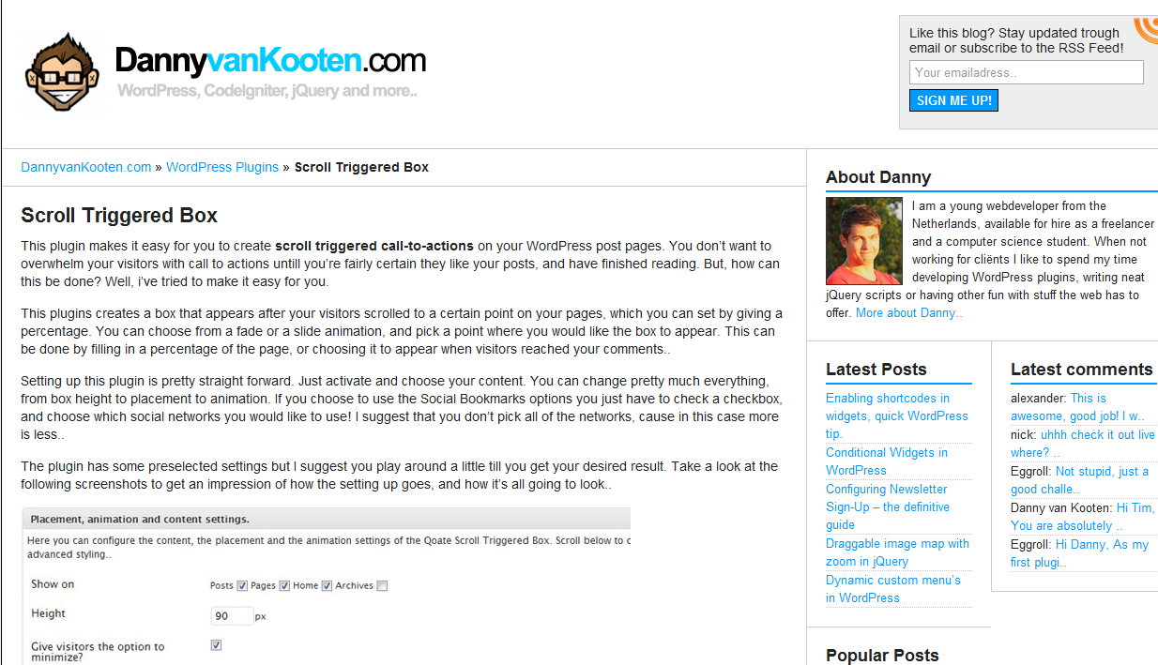
http://dannyvankooten.com/wordpress-plugins/scroll-triggered-box/

Slide 22
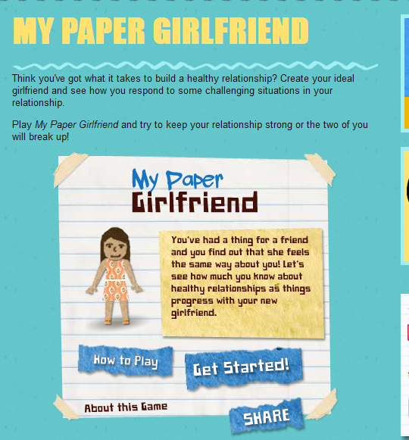
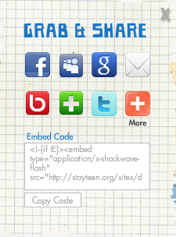
Make sharing CTAs an embedded part of content

Slide 23
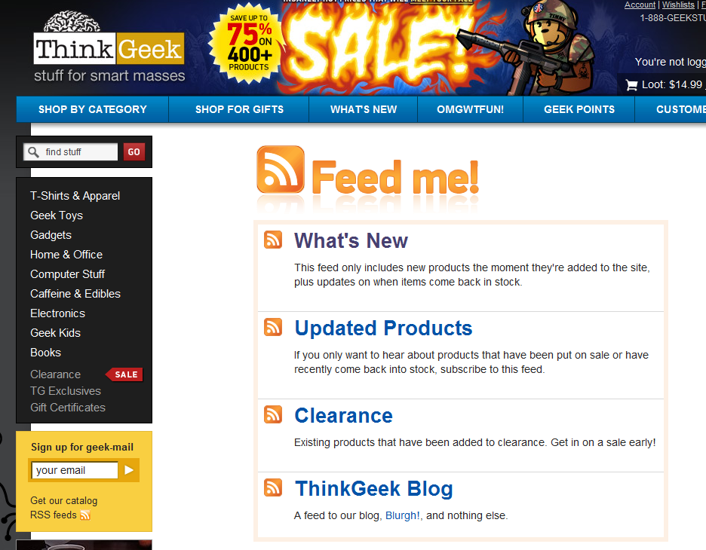
Target key microconversions. Especially email and RSS!

Slide 24
Get started with structured data

Slide 25
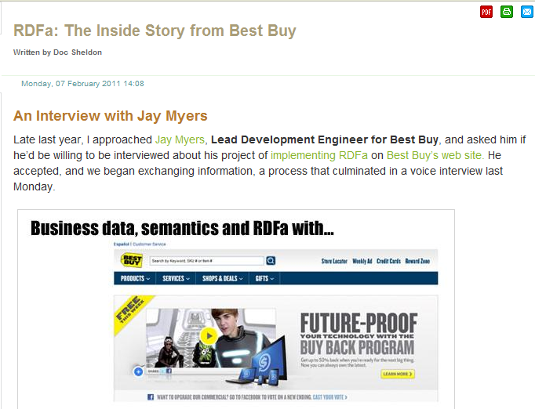
“Within just a couple of months, we began to see an increase in our organic search results. Before long, it had increased by 30% over historical rates.”
Best Buy and RDFa - http://searchnewscentral.com/20110207129/Technical/rdfa-the-inside-story-from-best-buy.html

Slide 26
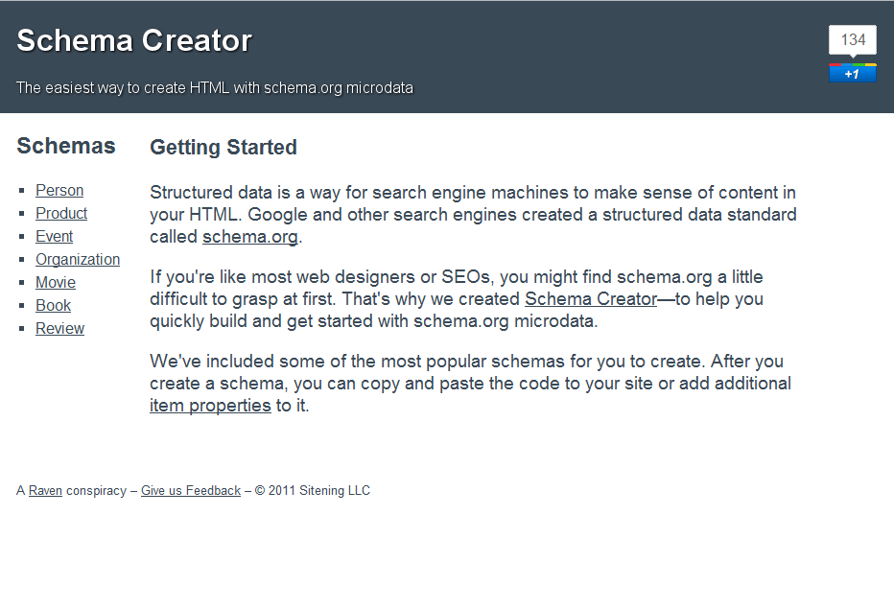
Schema - Get started with it. - http://schema-creator.org/ and http://www.searchenginepeople.com/blog/howto-add-schema-wordpress.html

Slide 27
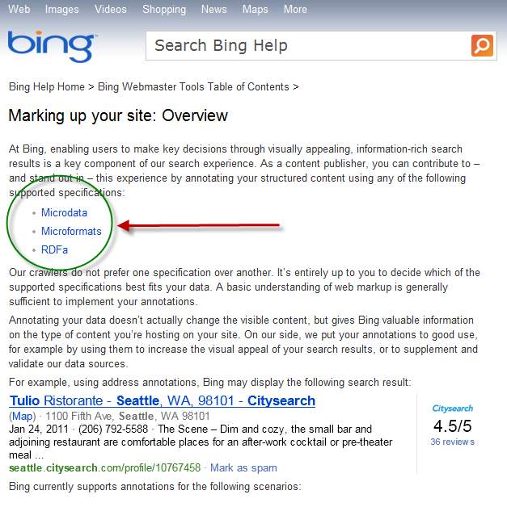
If you’re just in it for structured data for SEO, go with Schema.
But consider all your options.

Slide 28
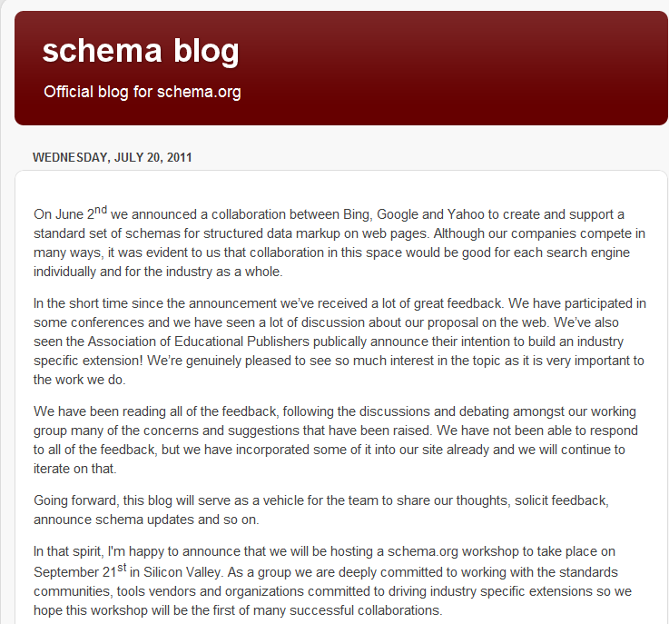
http://blog.schema.org/ - Keep up with the latest from the semantic community. Follow what happens on the 9/21 workshop.

Slide 29
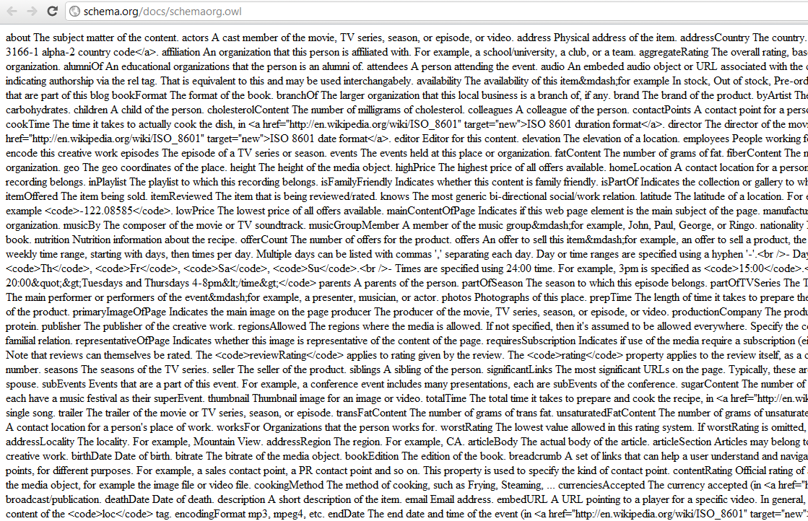
What’s this mess?! http://schema.org/docs/schemaorg.owl - It allows the schema.org schemas to be used with all OWL-aware tools such as editors, validators etc as well as to create mappings to other Semantic Web schemas.

Slide 30
The dilemma: Making great content that’s scalable and profitable.

Slide 31
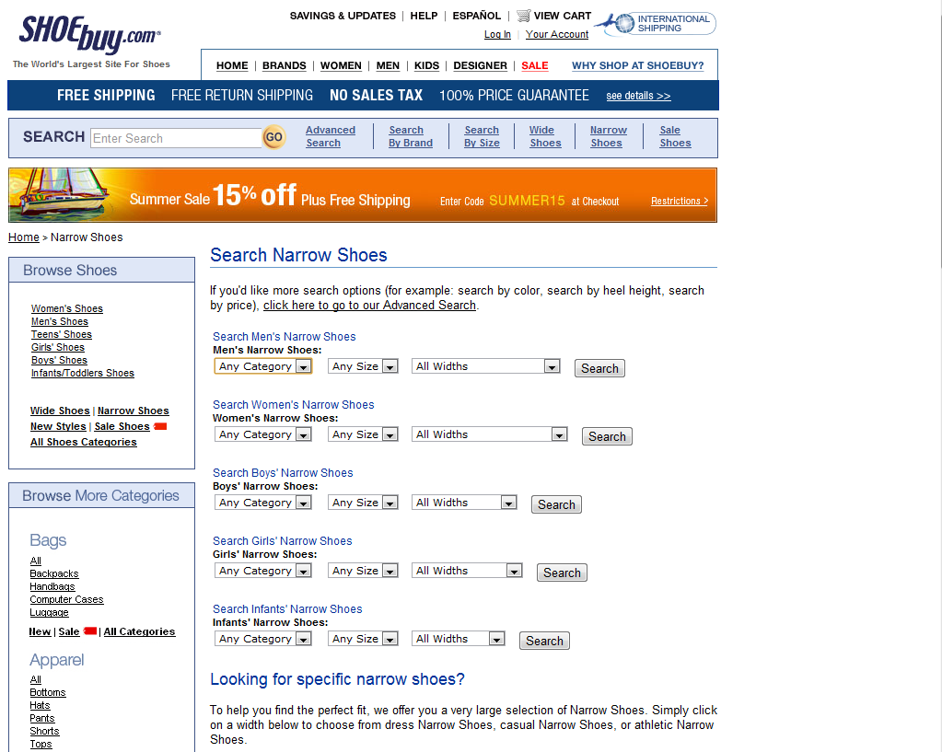
Sparse content and search features? Risky.

Slide 32
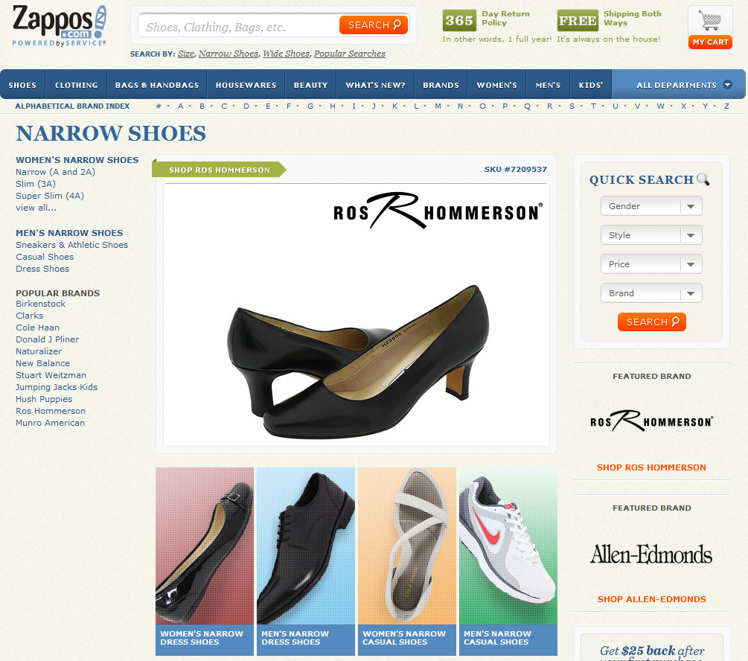
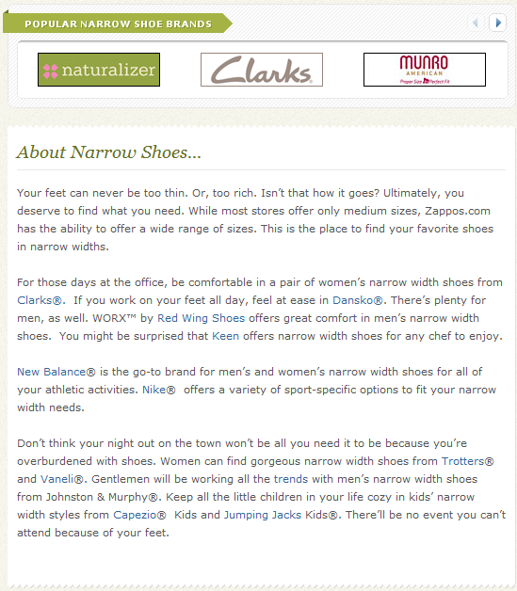
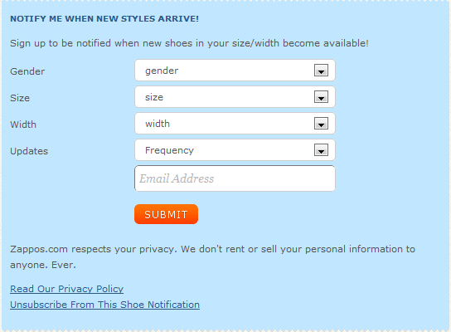
Not all pages will be “great”. But ALL pages should be useful.

Slide 33
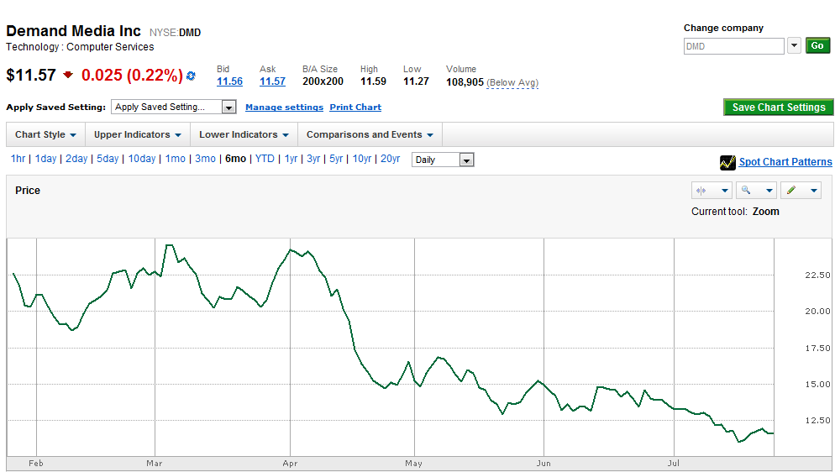
Inefficient publishing: It leads to Panda or worse.

Slide 34
The Future: Linked Data

Slide 35
Linked Data is a web of things instead of a web of documents
Using Linked Data, we can combine and query different data types
What’s Linked Data? What are the technologies that drive it? http://ode.openlinksw.com/#What_is_Linked_Data & http://linkeddata.org/

Slide 36
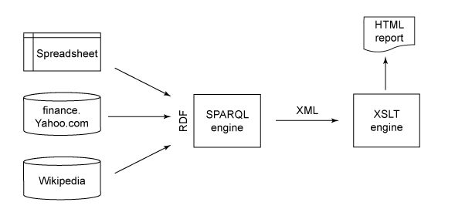
http://www.ibm.com/developerworks/library/x-disprdf/index.html

Slide 37
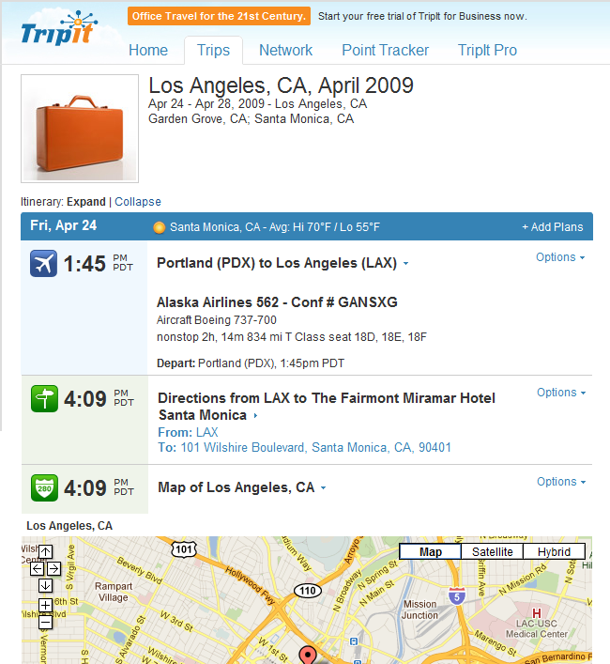

Slide 38
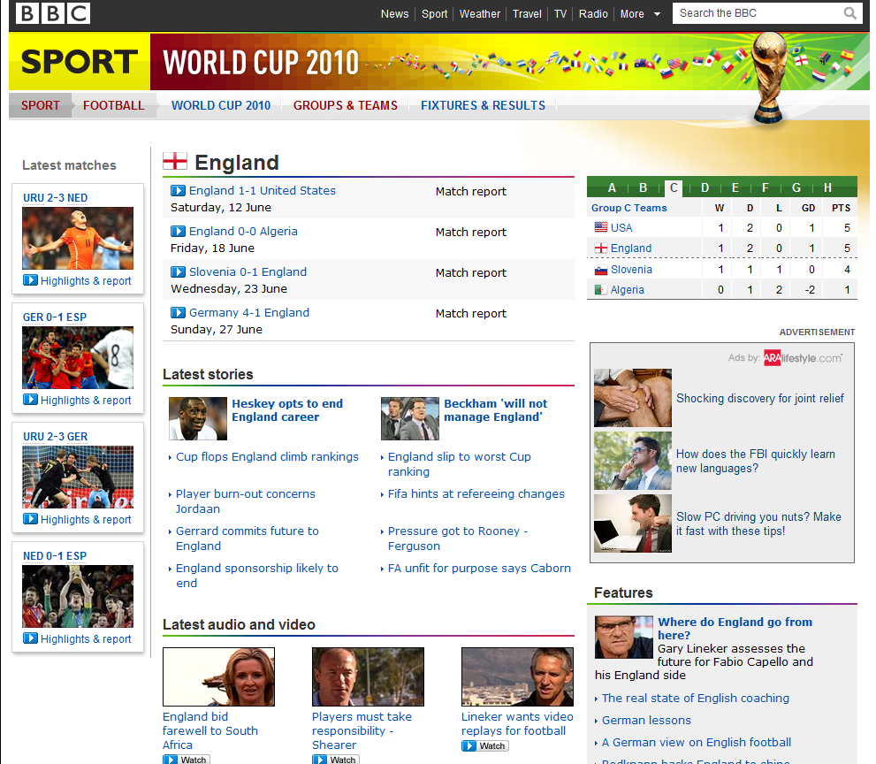
All these modules are data contained in a RDF database.
http://www.bbc.co.uk/blogs/bbcinternet/2010/07/the_world_cup_and_a_call_to_ac.html http://www.bbc.co.uk/blogs/bbcinternet/2010/07/bbc_world_cup_2010_dynamic_sem.html

Slide 39
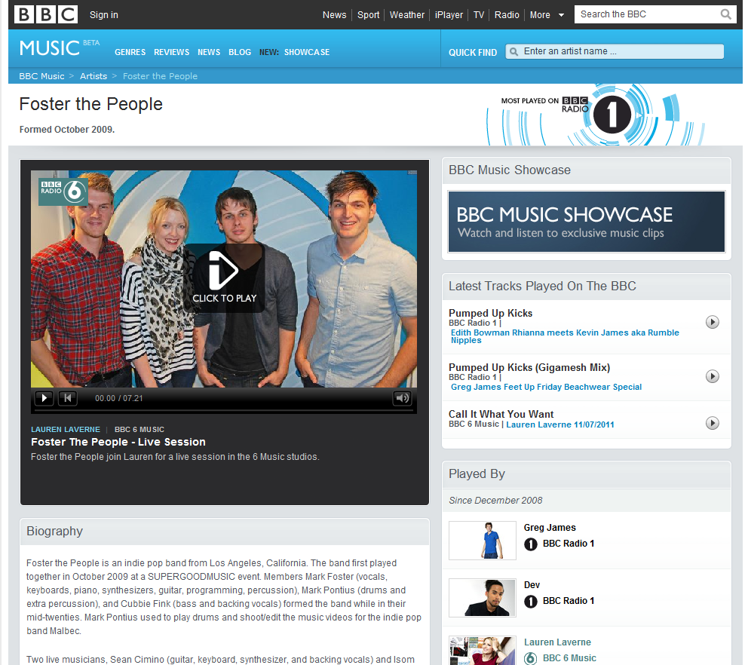
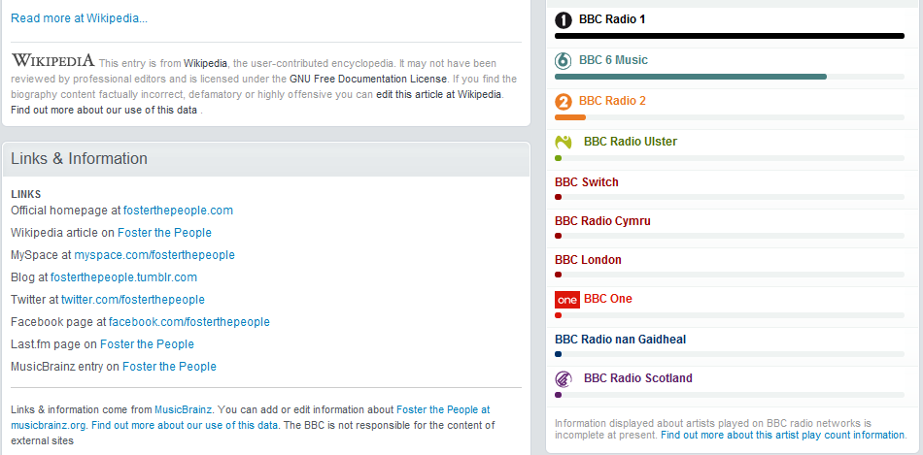
Linked open data from dbpedia, MusicBrainz, and BBC’s own datastore

Slide 40
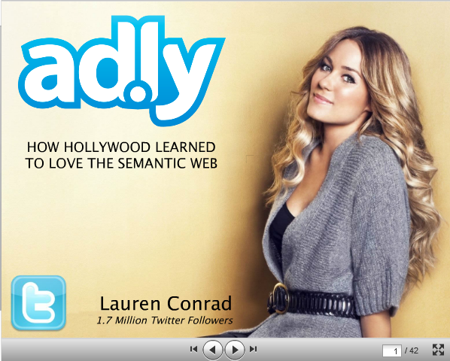
Check out how ad.ly uses linked data
http://semanticweb.com/five-steps-to-linked-data-integration_b20876

Slide 41
Could limited data mean the Beeb promotes the Swagger Wagon??

Slide 42
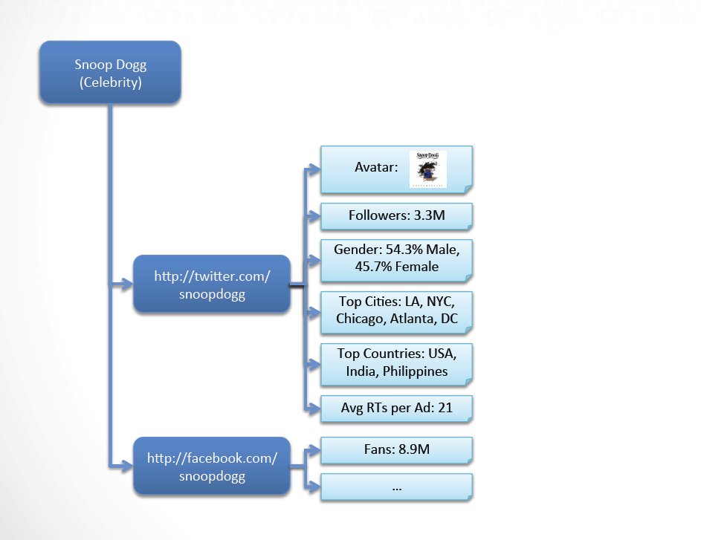
Ad.ly has basic information on a celeb
http://semanticweb.com/five-steps-to-linked-data-integration_b20876

Slide 43
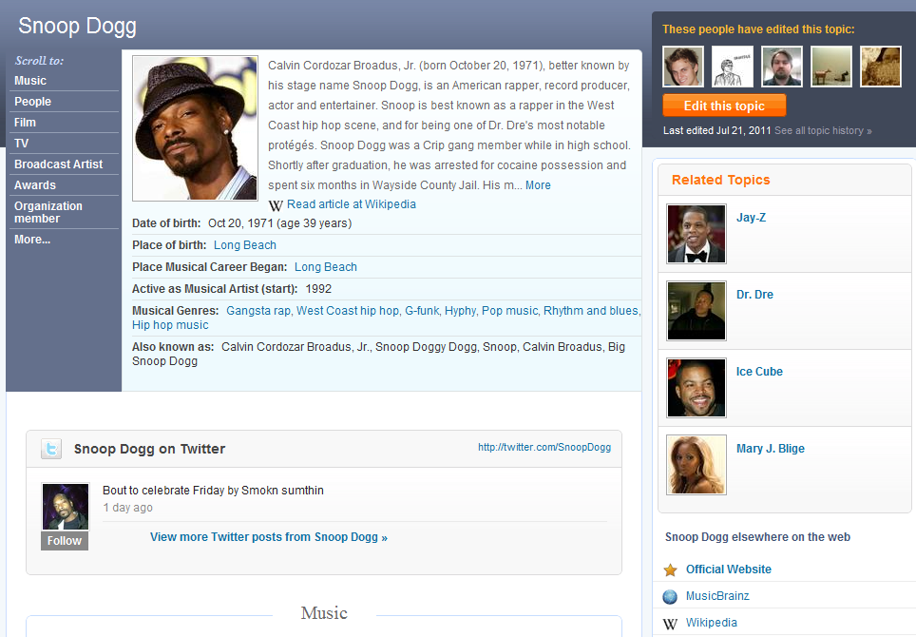
Freebase and Musicbrainz provide round out the data

Slide 44
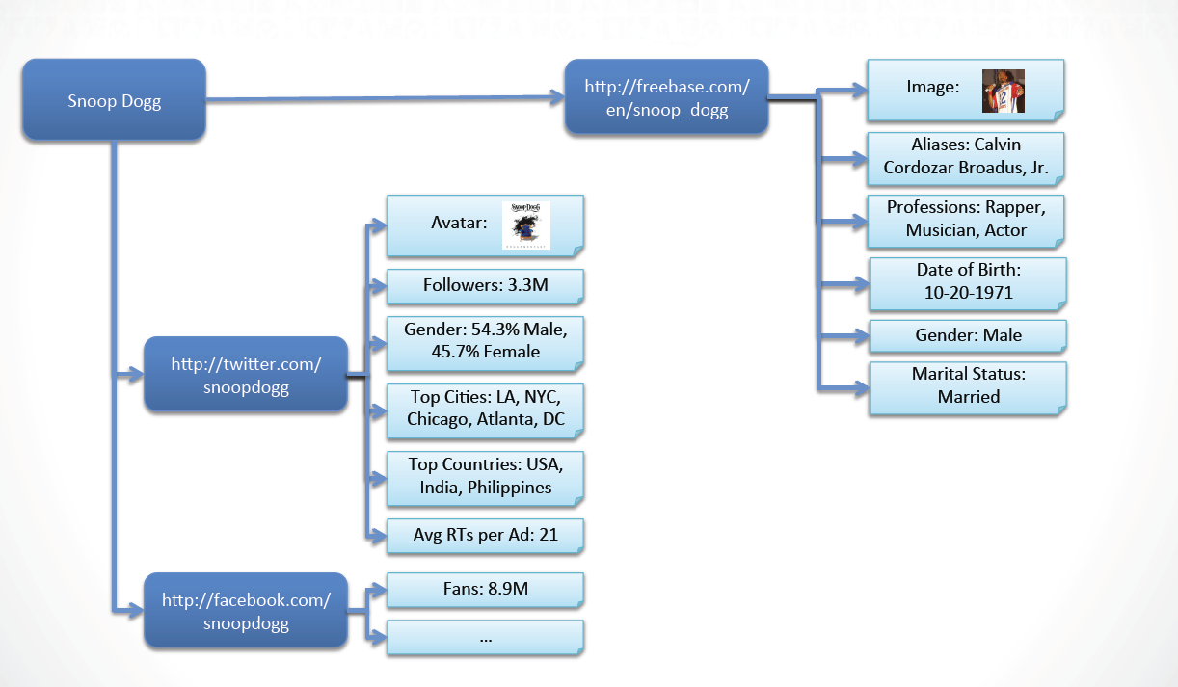

Slide 45
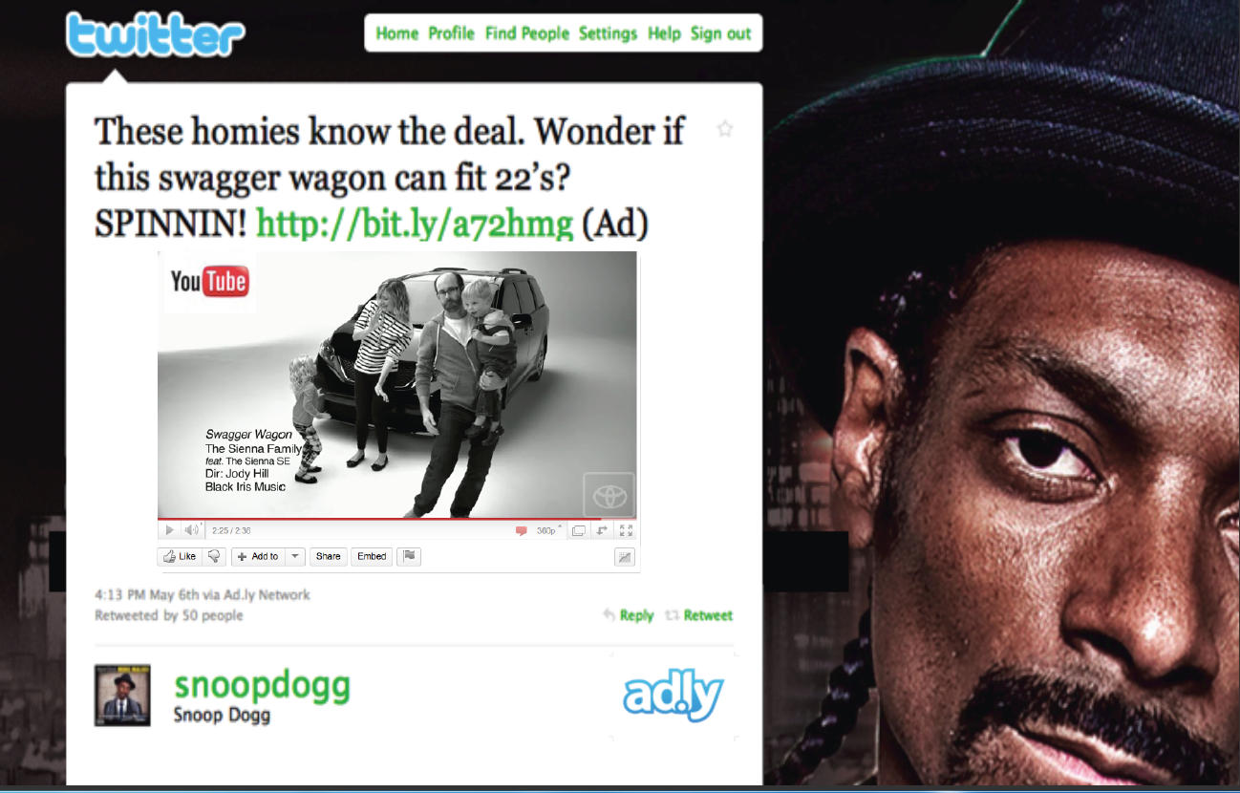
http://www.slideshare.net/testac/how-hollywood-learned-to-love-the-semantic-web

Slide 46
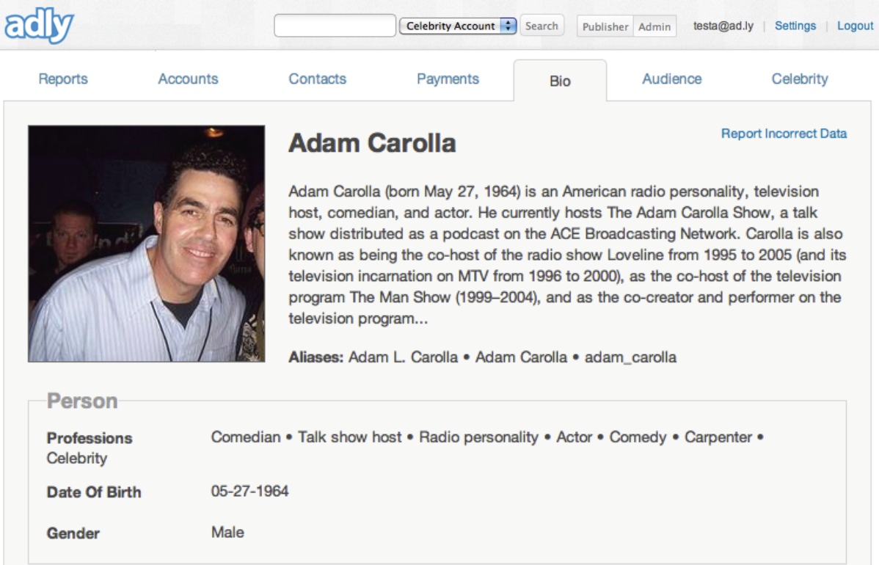
The more data you integrate, the better business intelligence you’ll have - for both content and other purposes

Slide 47
Make *unique* content using your own data combined with Linked Open Data!

Slide 48
Linked Data Resources and Tools

Slide 49
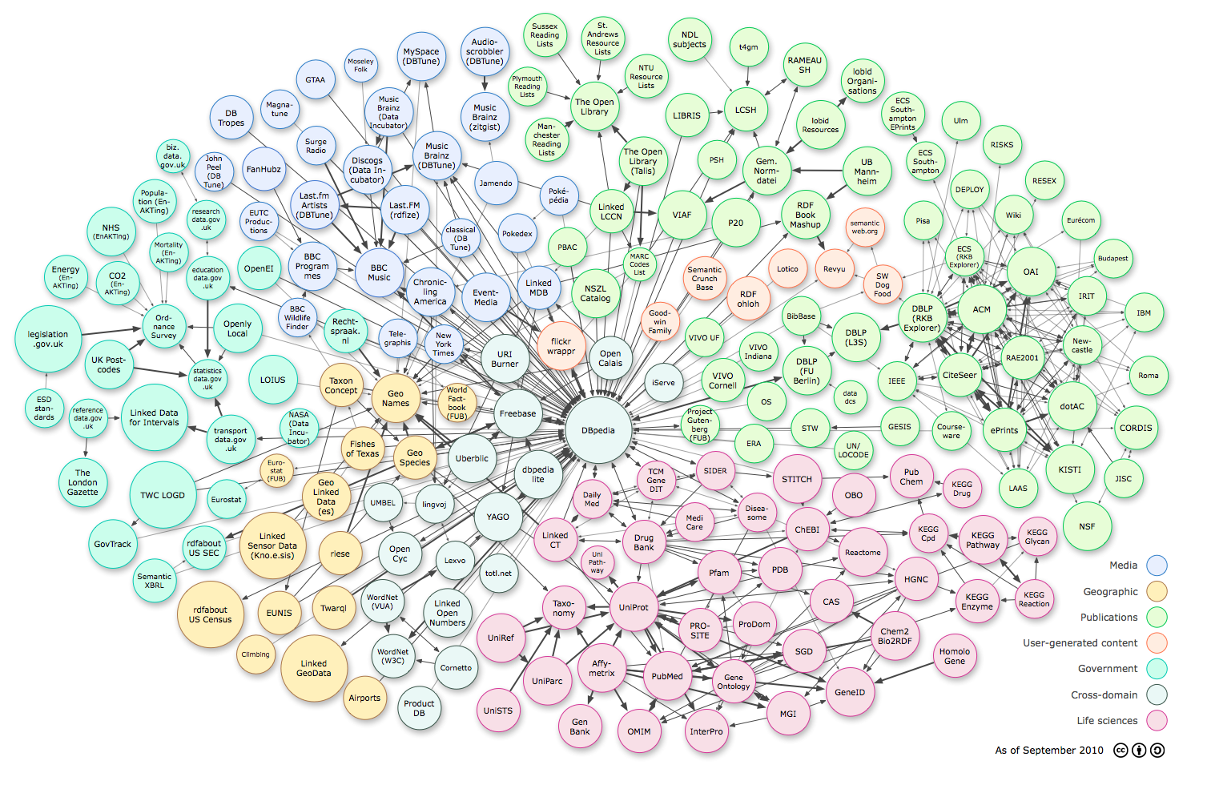
http://richard.cyganiak.de/2007/10/lod/ - Linking Open Data Cloud

Slide 50
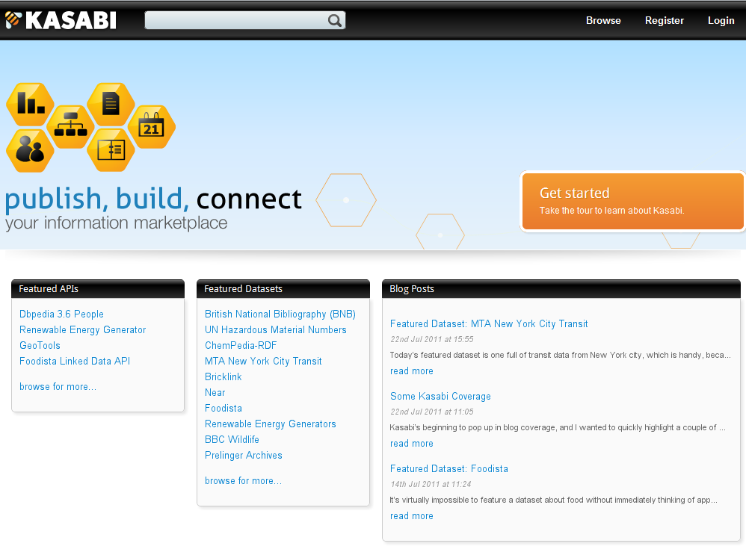
http://beta.kasabi.com/ - Tons of useful curated datasets

Slide 51
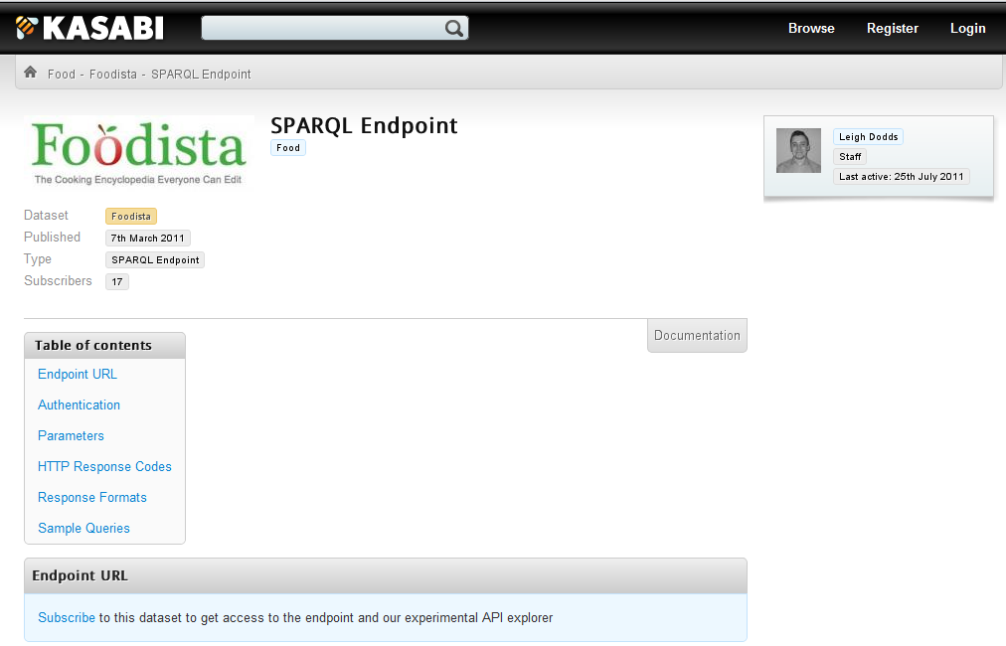
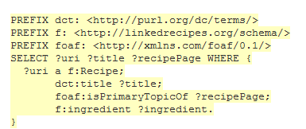
Example of how to use a food-related SPARQL query on a Kasabi dataset

Slide 52
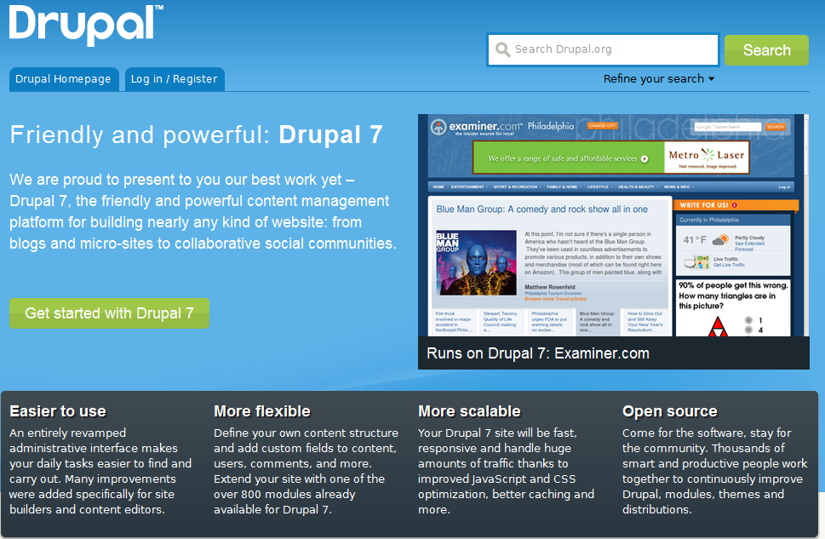
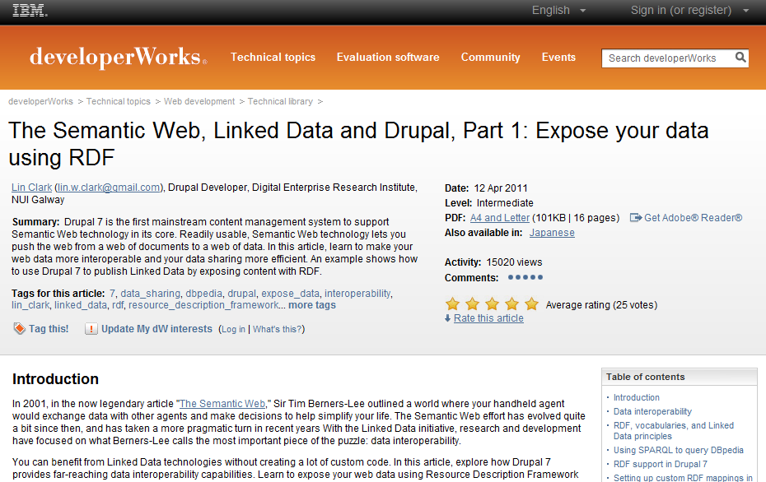
Using RDF in Drupal 7 - https://www.ibm.com/developerworks/web/library/wa-rdf/ and http://www.ibm.com/developerworks/library/wa-datasets/

Slide 53
Ontotext – http://www.ontotext.com/ - Semantic Tech provider of RDF databases (OWLIM)

Slide 54
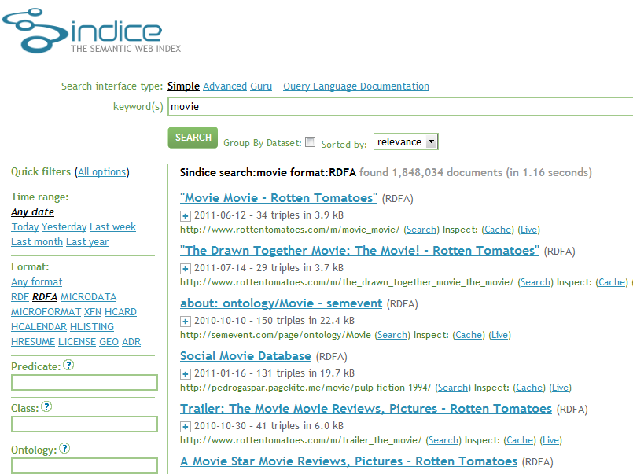
Sindice.com – Semantic web search engine. Good way to see what sites are doing with linked data

Slide 55
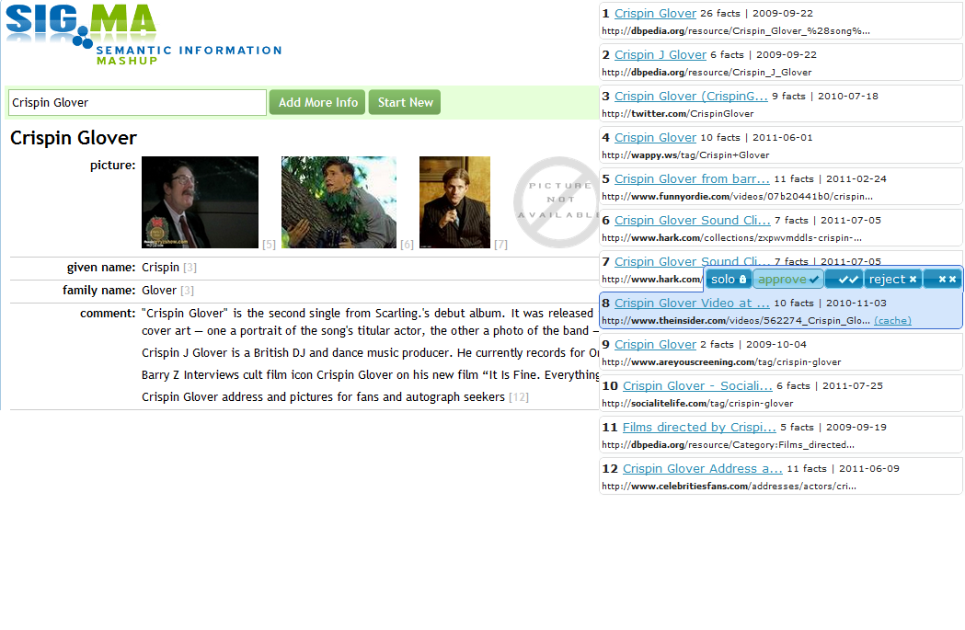
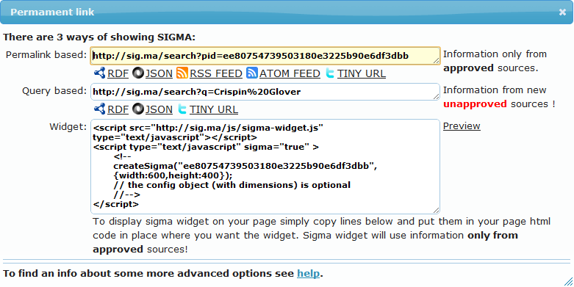
Sig.ma – Semantic web search engine by term. Lets you choose sources and provides embedding options

Slide 56
Other Linked Data Resources on the Web
http://www.linkeddatatools.com/semantic-web-basics
Semantic Web Primer – Start Here
http://semanticweb.com/introduction-to-rdf_b17953 - Dead simple intro to RDF and associated vocabularies and tools. SemanticWeb.com rules.
http://www.w3.org/2011/Talks/0607-SemTech-RDFa-IH/Talk.pdf
Great intro to RDFa and highlights Best Buy, Overstock, Examiner.com
http://www.ibm.com/developerworks/library/x-disprdf/index.html
IBM Developer Works tutorial on how to combine data
http://searchnewscentral.com/20110207129/Technical/rdfa-the-inside-story-from-best-buy.html
Interview with Jay Myers, Lead Development Engineer for Best Buy
Twitter folks to follow (who have SEO/SEM crossover):
Aaron Bradley - @aaranged – SEOskeptic blog is a must read
Sean Golliher - @SeanGolliher – Publisher of SEMJ – writes on SEMtech
Jay Myers - @jaymyers – Best Buy lead dev and RDFa proponent
There’s a ton of resources on the web to get you started

Slide 57
Linked Data + The Long Tail. Who wins?
Users: Kick ass content in one place
Search Engines: More reliable data
You: Happy Users. Money. Vacations.
A winner is everyone!

Slide 58
David Mihm wears trucker hats!

Slide 59
Thank you! Q+A Time
matthew@audiencewise.com
twitter: @matthewjbrown
LinkedIn: MatthewBrownPDX

